Slide 1

Alert Message Pop-up For DBT Face
Authentication

Slide 2
User Login & Access Flow
DBT Tab Not Visible (Condition)
DBT Tab Visibility (ABHA is Completed)
System Behaviour Summary
Required User Action
Contents

Slide 3
Login using credentials (PHI / TU / DTO)
Search Patient using Patient ID
Open patient record
System checks ABHA Face Authentication status
User Login & Access Flow

Slide 4
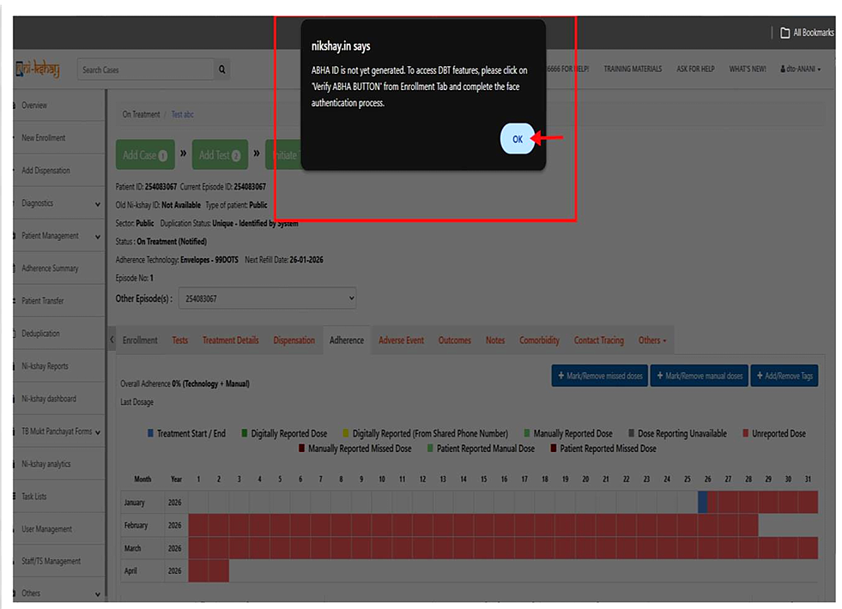

Slide 5
  If ABHA Face Authentication NOT done for patient, he will see a pop up on each tab when clicked
  DBT tab will NOT be visible as there is no ABHA address. User cannot proceed with DBT actions
  Each time pop up will comes till it's not done
DBT Tab Not Visible

Slide 6
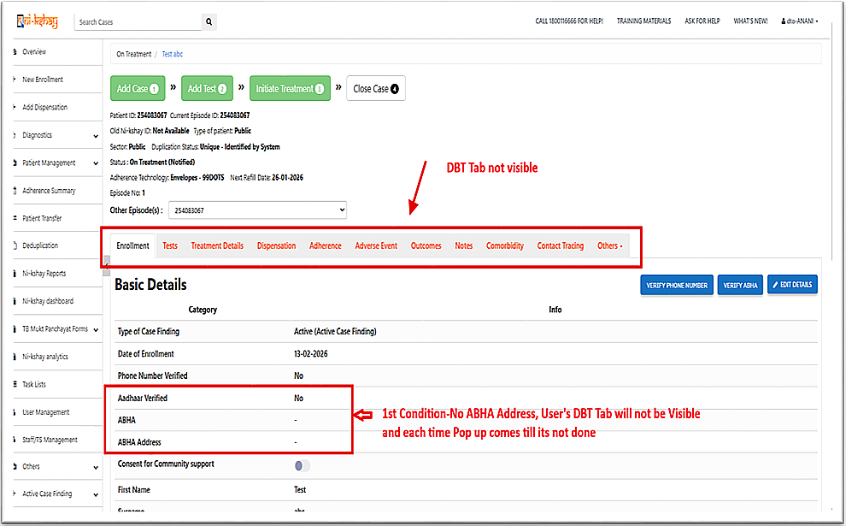

Slide 7
  When ABHA is completed for patient -
  DBT tab is visible
  ABHA Address available
  User can access DBT features
DBT Tab Visibility

Slide 8
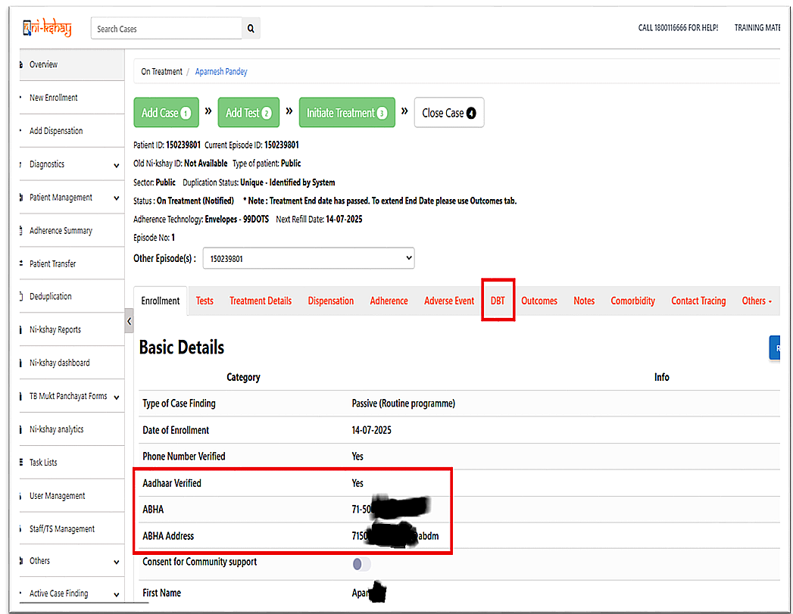

Slide 9
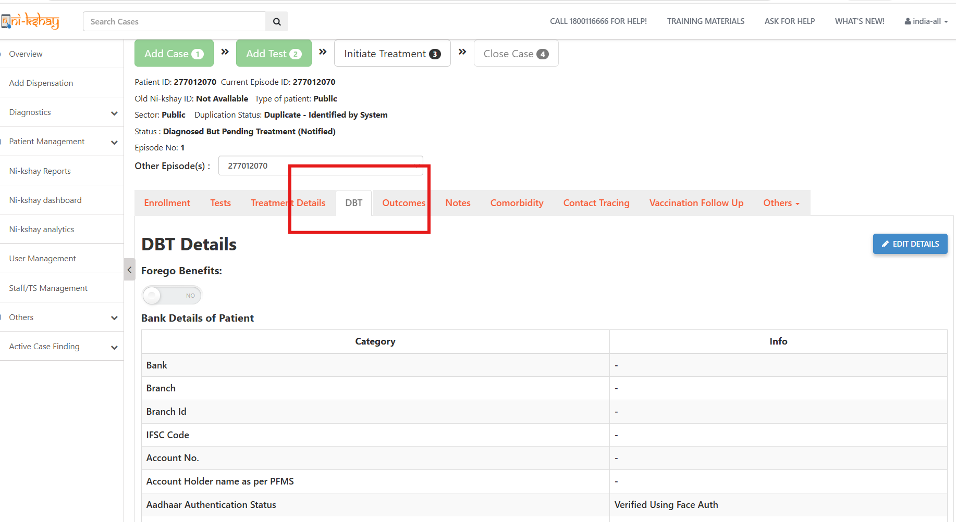

Slide 10
  Pop-up appears repeatedly
  Appears on every tab clicked
  Blocks DBT functionality
  Continues until authentication is completed
System Behaviour Summary

Slide 11
  Go to Enrollment Tab
  Click on Verify ABHA
  Fill details and Complete Face Authentication
  Generate ABHA ID
  Once ABHA ID generated ,DBT tab becomes visible
  Pop-ups stop appearing
  User can proceed normally
Required User Action

Slide 12
THANK YOU

