Slide 1

Addition of X-Ray in TB Screening

Slide 2
Overview
Requirement Summary
Add Test – TB Screening
Action Needed & Clinical Diagnosis Flow
Duplicate Test Records Creation
Contents

Slide 3
This document explains the implementation of adding Chest X-Ray as a screening tool for TB and using screening X-Ray data for clinical diagnosis.
Chest X-Ray has been added as a screening option under “Reason for Testing” to support early detection of Tuberculosis (TB).
The application interface includes a dedicated “TB Screening” option, enabling structured recording and use of X-Ray screening data.
Overview

Slide 4
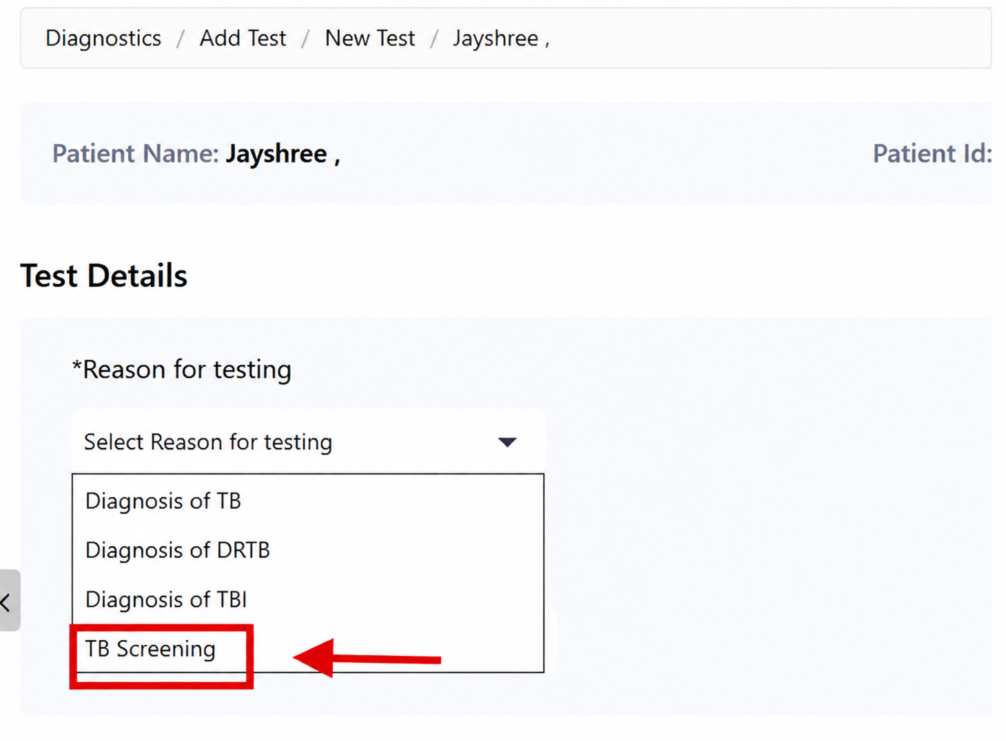

Slide 5
  Add “TB Screening” as a new reason for testing.
  Chest X-Ray can now be selected only under TB Screening.
  X-Ray option is removed from direct Diagnosis of TB
  Clinical diagnosis is allowed through a controlled action flow
Requirement
Summary

Slide 6
  ‘TB Screening’ is selected as the reason for testing.
  Chest X-Ray option is enabled only when “TB Screening” is selected as the Reason for Testing.
  Along with this, other patient details like symptoms and duration are recorded.
Add Test:TB
Screening

Slide 7
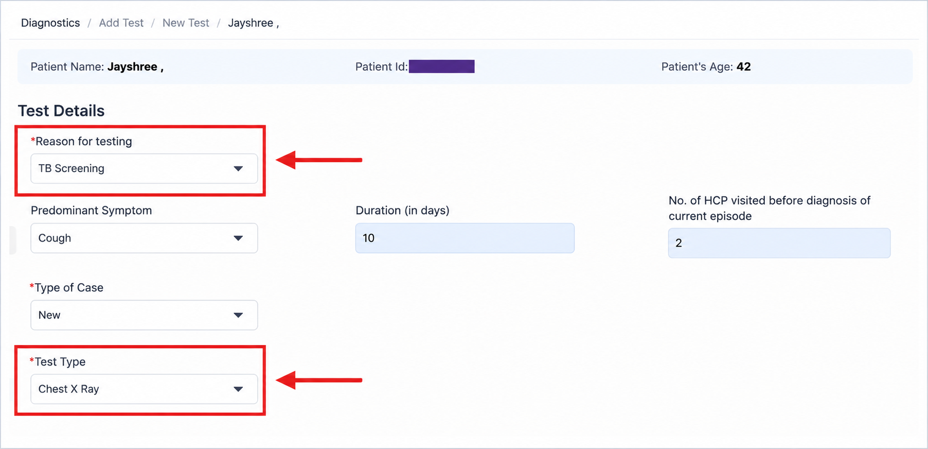
Add Test – TB Screening

Slide 8
  1. Test Initiation -
  Select Reason for Testing as Diagnosis of TB
  Choose Test Type as Chest X-Ray
  Capture patient symptoms, duration, and visit history
Action needed & Clinical Diagnosis Flow

Slide 9
  2. Test Result Entry-
  Select Final Interpretation:
Normal
Abnormal – Suggestive of TB
Abnormal – Not Suggestive of TB

Slide 10
  3. Final Diagnosis-
  Cases marked “Abnormal – Suggestive of TB” move to Clinical Review
  Option to proceed with clinical diagnosis based on X-ray findings
  If proceeding clinically: Select Clinically Diagnosed TB
  If not: Mark as Not Suggestive of TB

Slide 11
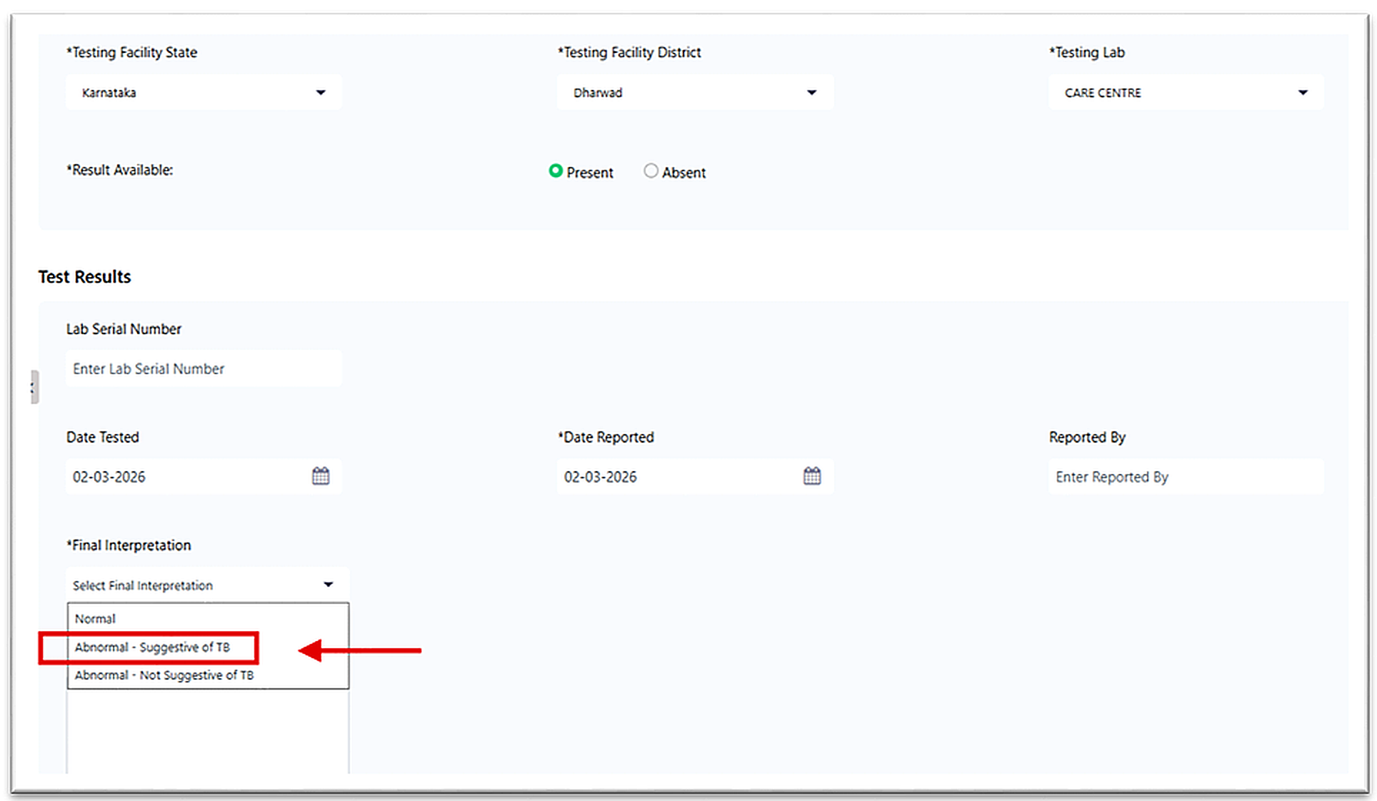

Slide 12
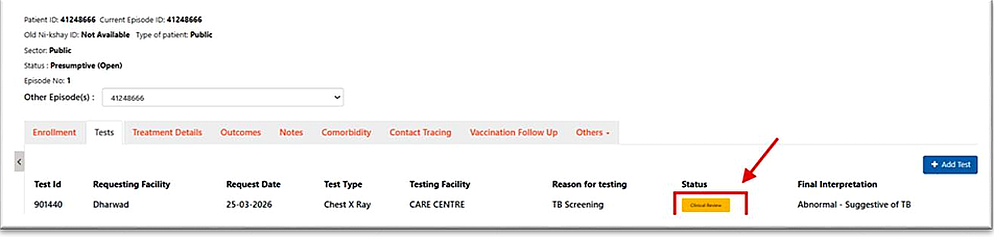

Slide 13
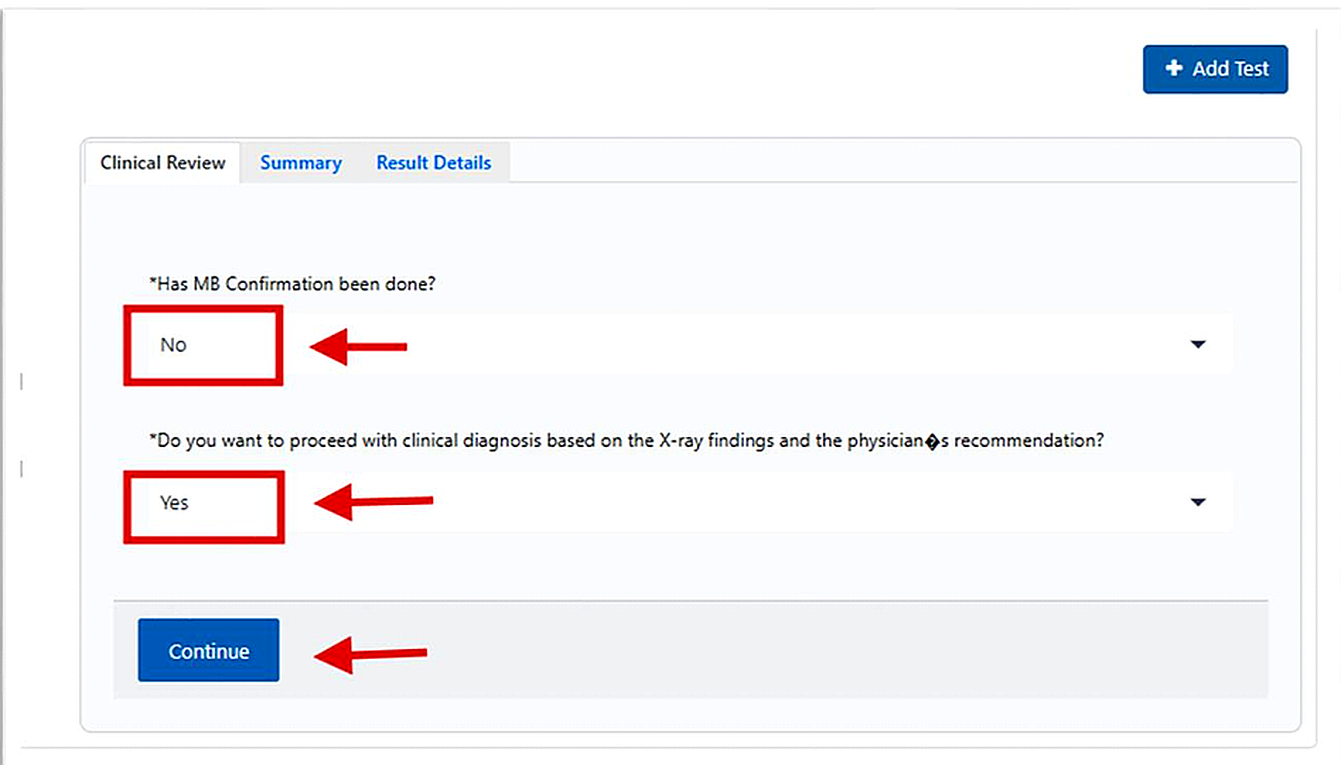

Slide 14
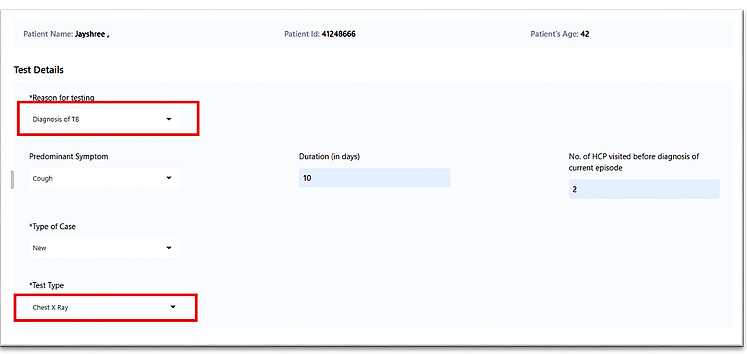

Slide 15
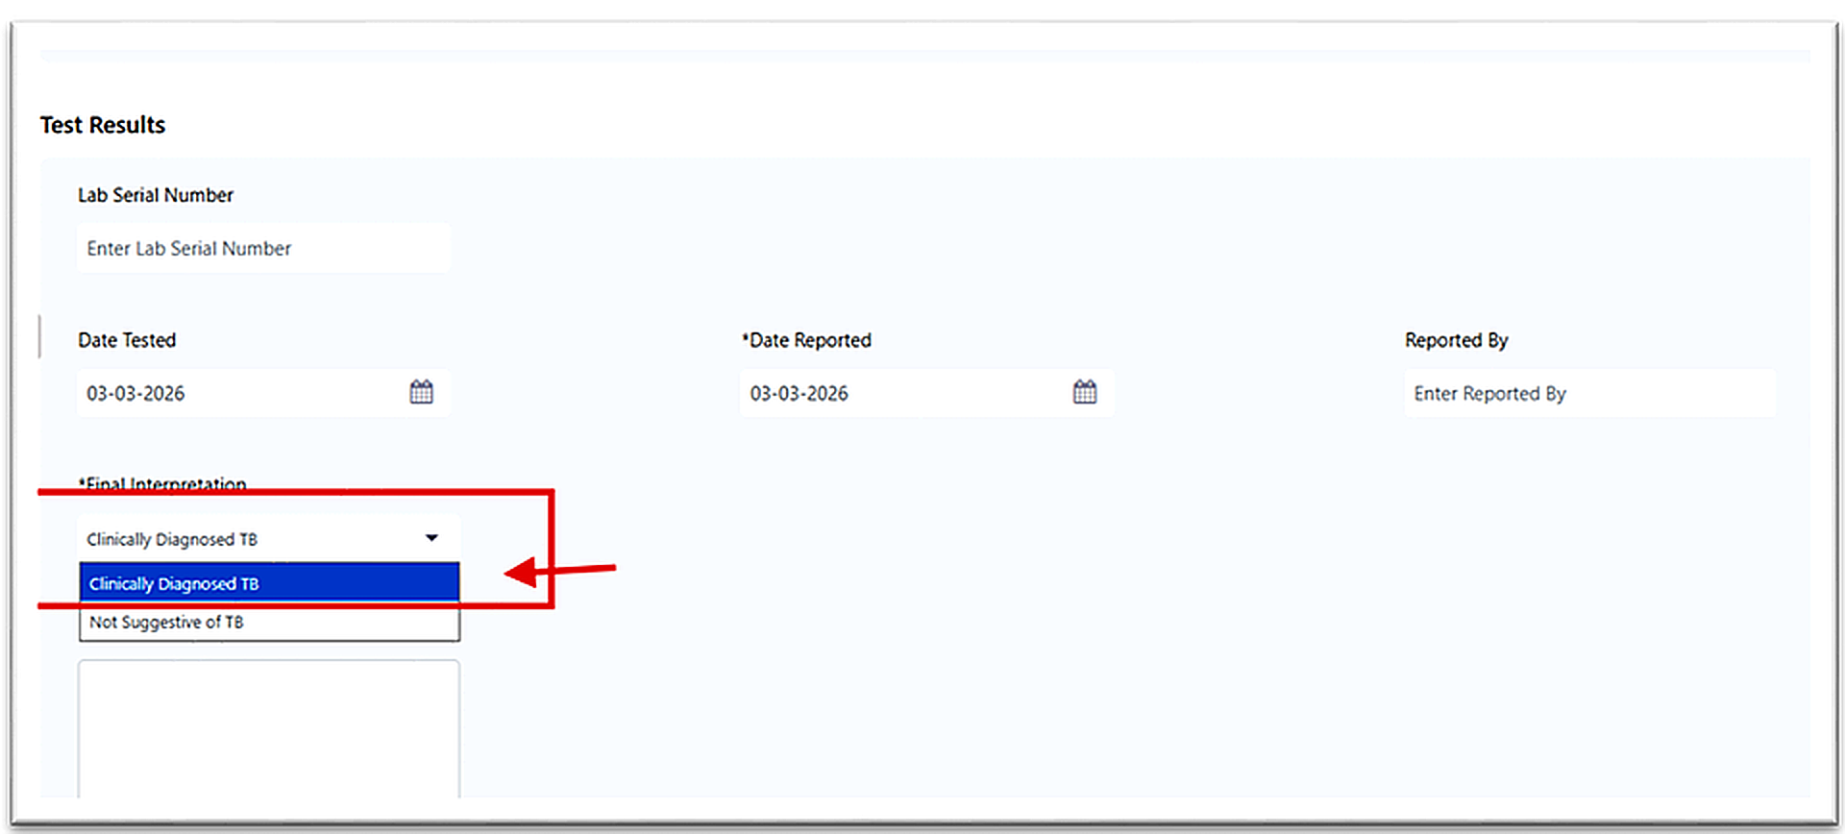

Slide 16
  After confirmation, the system creates a duplicate X-Ray test:
  1. Original test: Reason = TB Screening
  2. New test: Reason = Diagnosis of DSTB
  This ensures clear audit trail and reporting separation.
  X-Ray Test added and Final Interpretation Clinically diagnosed TB
Duplicate Test Records Creation

Slide 17
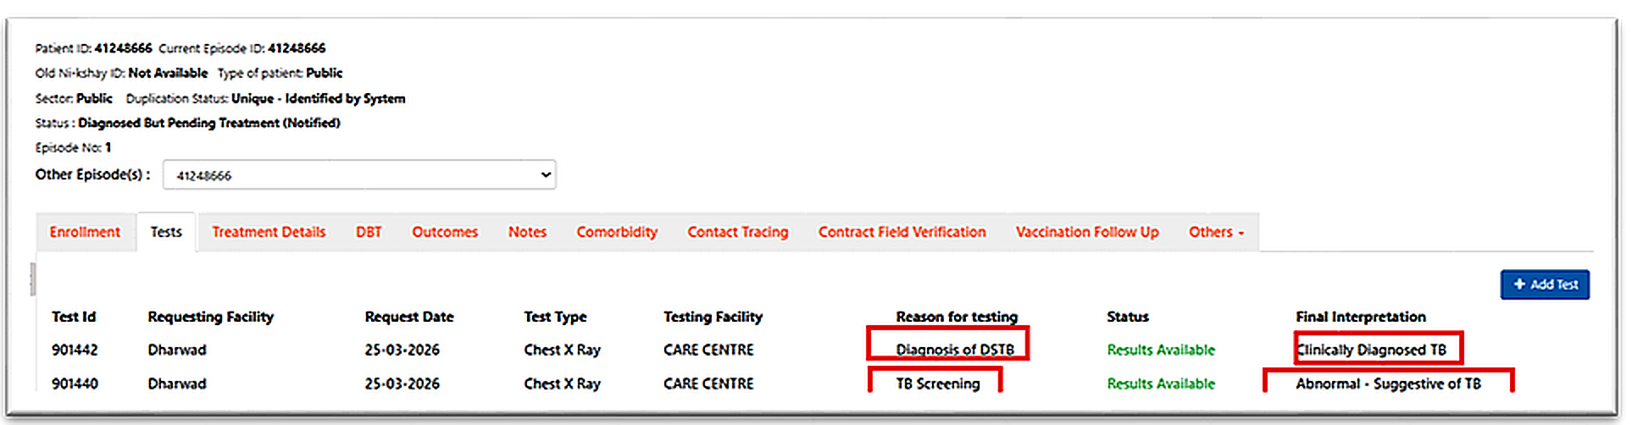

Slide 18
THANK YOU

