Slide 1
Contents
Add Test (DST – Drug Type)

Slide 2
Add Test
  Single screen to add Diagnostic or Follow Up tests for Public or Private sector patients
  To register a PATIENT, it is compulsory to add a POSITIVE DIAGNOSTIC test
  Add Test is a 2-step process, 1) Test Request and 2) Result Update.
  These steps can be done by a user at once or by two different users.
    Eg. 1: TB HV (enrols case + Requests Test) → LT (enters result)
    Eg.2: TB HV or LT (enrols case+ Request Test+ Enter Result)
  As soon as a positive test result is entered, the patient gets notified

Slide 3
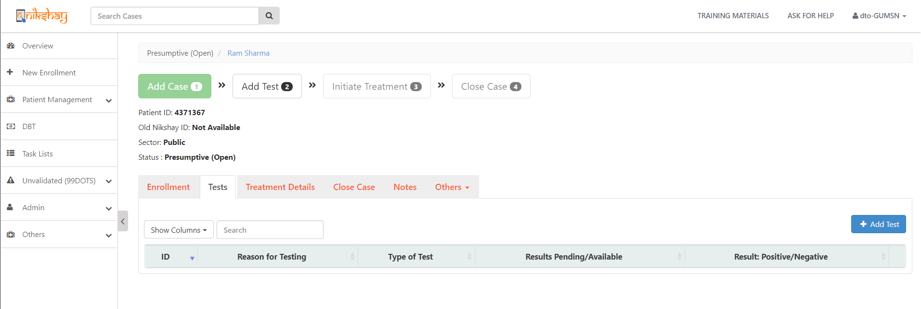
Add Test details
Step 1
Step 2
Step 3
Search case for which Test to be updated
Open Patient record and select Tests section
Click on Add Test
White color box indicates “Add Test” is pending
As no test is added, status is “Presumptive(Open)”
Details of tests added earlier (if any) are shown here

Slide 4
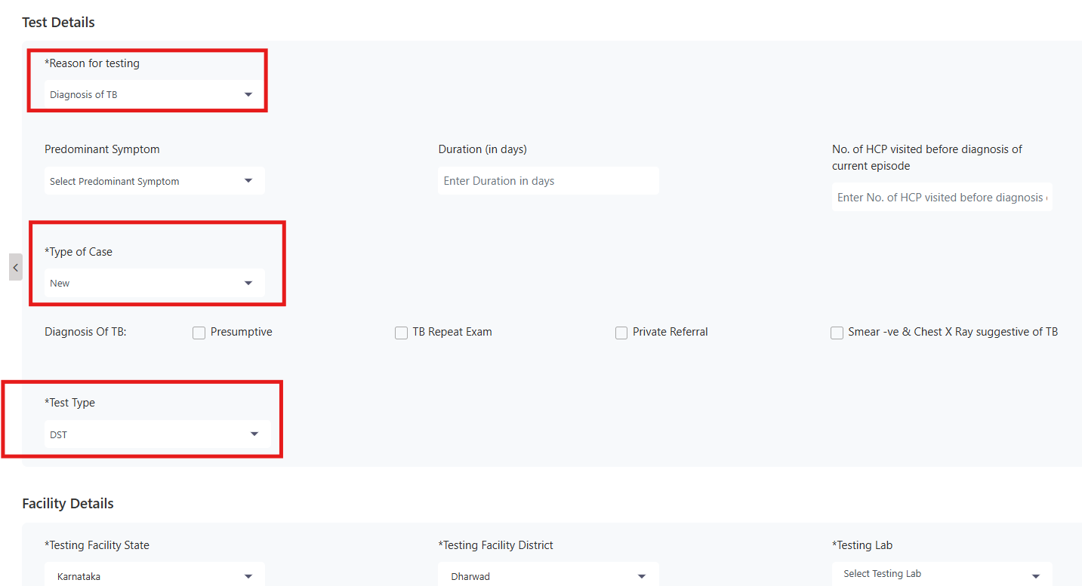
Red color box indicates “Reason of testing”
Red color box indicates “Type of Case”
Red color box indicates “Test Type == DST”

Slide 5

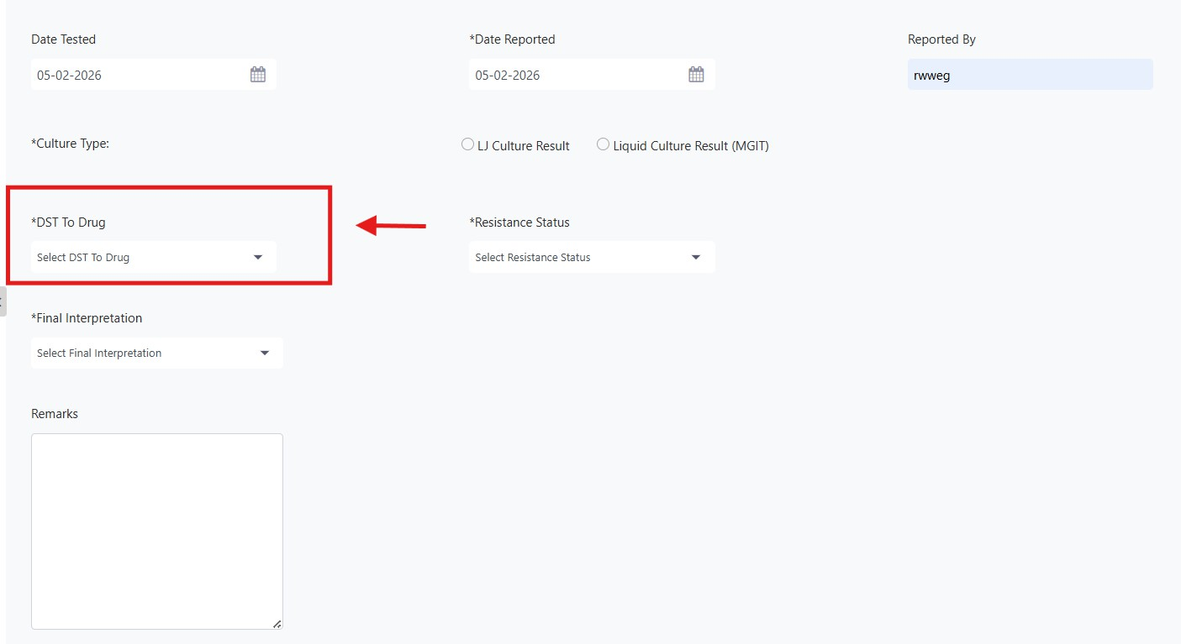
Red color box indicates “DST to Drug”

Slide 6
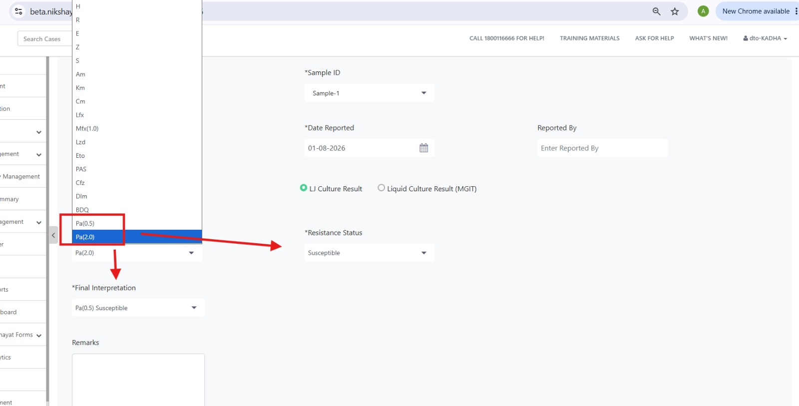
Red color box indicates “Drug Type”

Slide 7
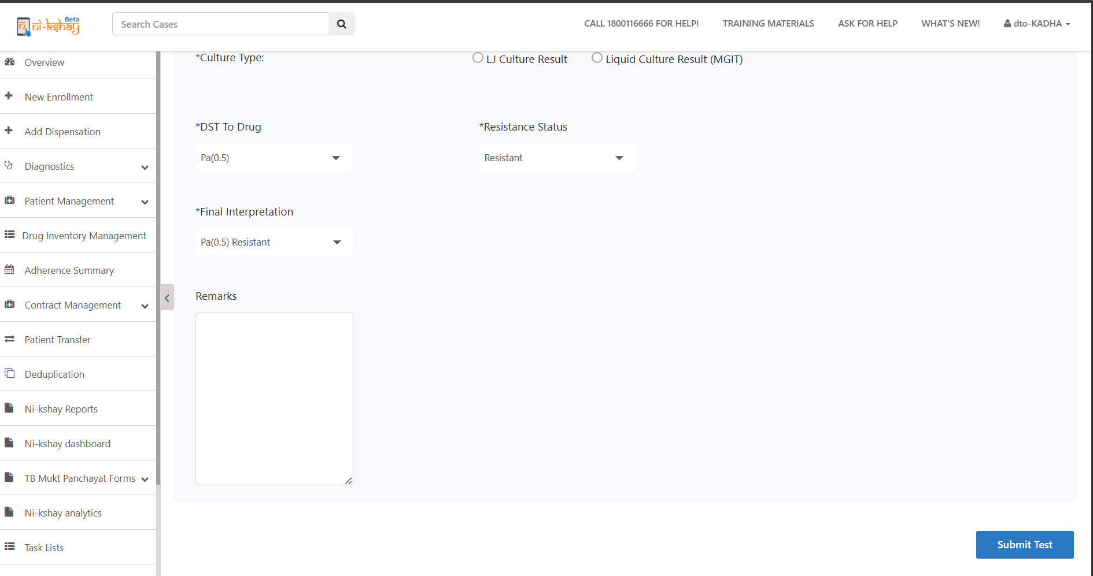
Click on Submit Test

Slide 8
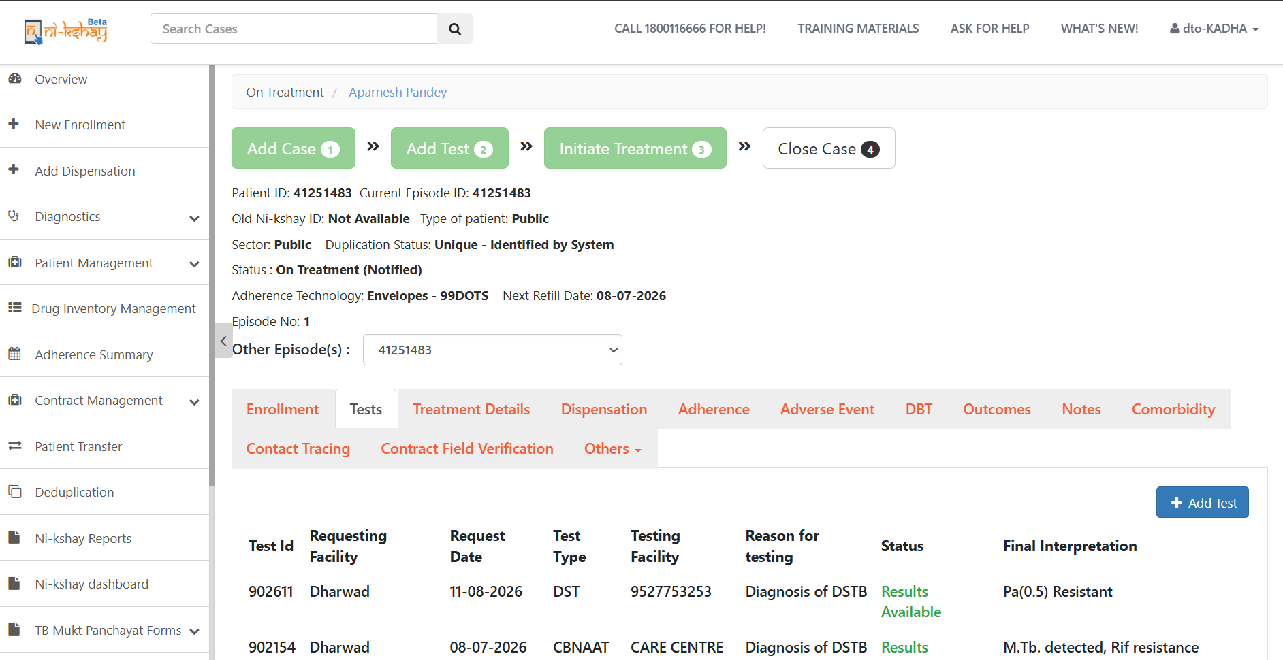
Test details
Step 1
Step 2
Step 3
Step 4
Step 4
Search case for which Test to be updated
Open Patient record and select Tests section
Click on Add Test
Enter Test Details
View Test Details
Green color box Indicates Test updated
On entering a +ve diagnostic test, case status changes to Patient
Tests added are shown here

Slide 9
THANK YOU

