Slide 1

Biometric Authentication -
Nikshay Web

Slide 2
Prerequisites
Driver Installation Check (Optional)
Initial Pop-ups
Login & Navigation
Authentication Process
If Authentication Fails
Contents

Slide 3
Visit below url: https://mantratec.com/Download/User First Download
Download and Install -
Install MFS110 Driver
Install MFS110 RD Service
Install driver as per device
Prerequisites

Slide 4
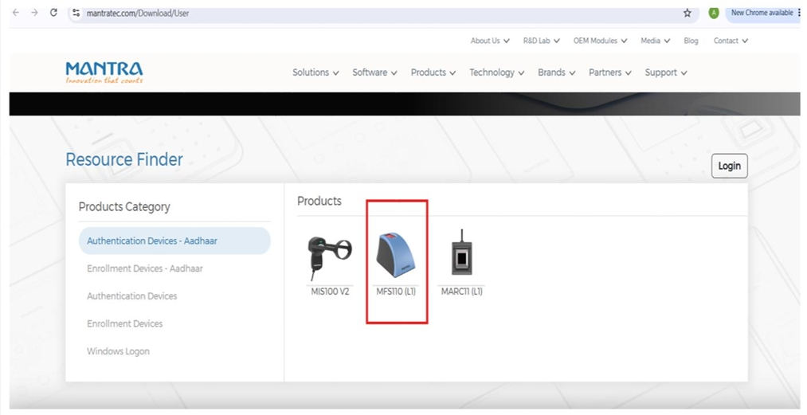

Slide 5
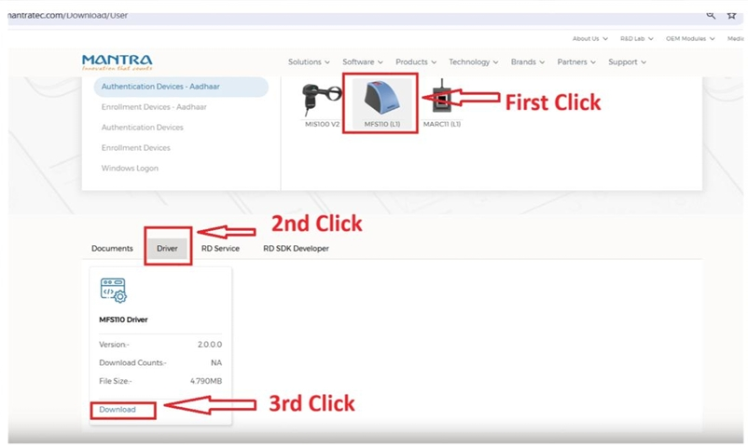
Download complete & Install MFS110 Windows RD Service

Slide 6
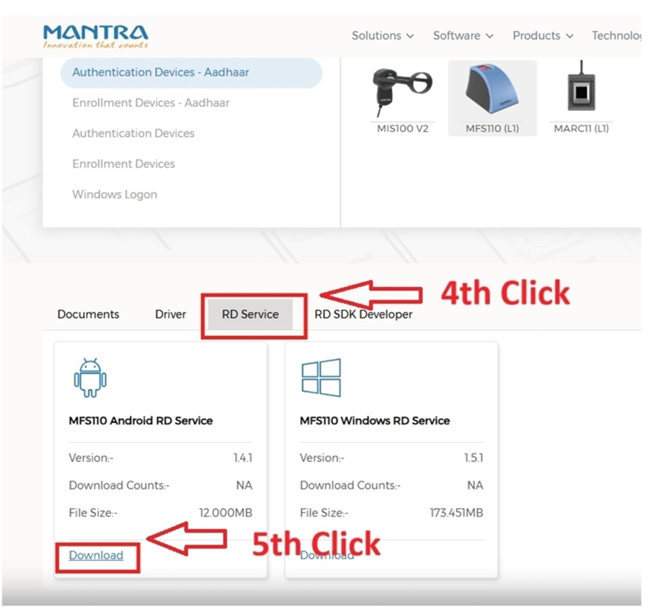
Download and install both above drivers

Slide 7
  Optional -To Check Port Number -
  Search CMD
  Open CMD
  Paste below command and enter -
netstat -ano | findstr 11100
  To Check Driver installed >> Service.msc >>Open
  Once Driver Installed Successfully, red color light blinks in Finger Authentication Machine
Driver Installation Check
(Optional)

Slide 8
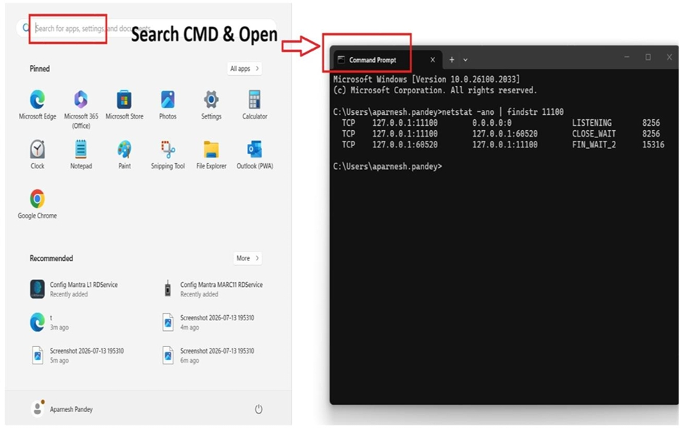
Optional -To Check Port Number >> Search CMD>>Open CMD>>Paste below command and enter
netstat -ano | findstr 11100

Slide 9
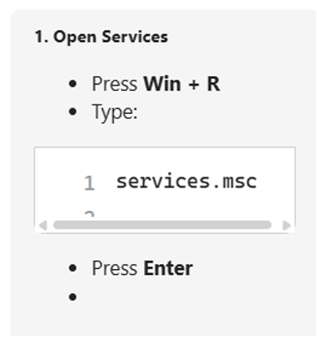
Optional -To Check Driver installed >> Service.msc >>Open

Slide 10
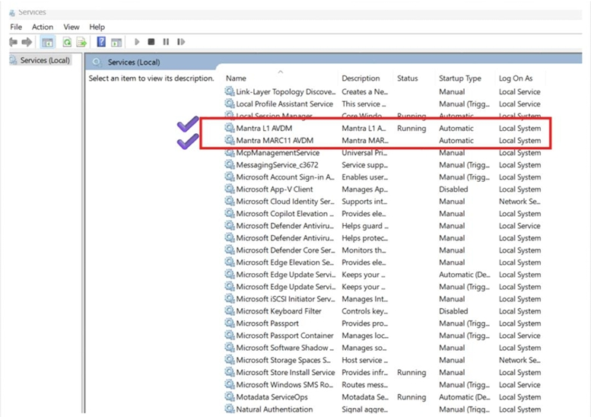
Every Driver Installed Successfully

Slide 11
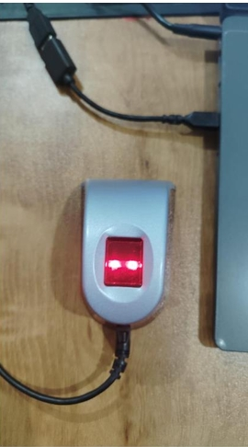
Red color light blinks in Finger Authentication Machine

Slide 12
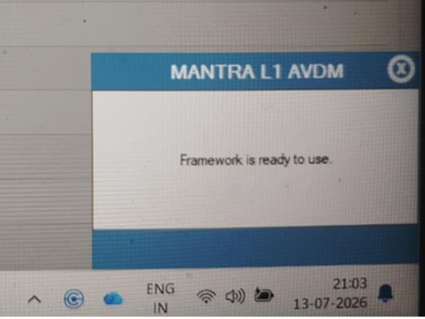
We get this 1st pop up on screen

Slide 13
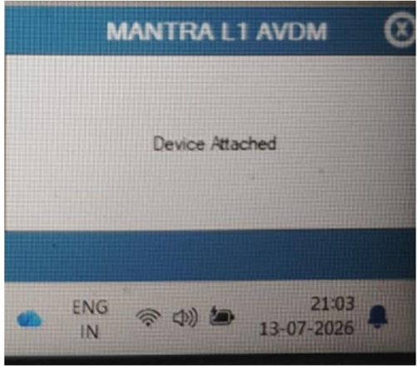
We get this 2nd pop up on screen

Slide 14
Login with DTO/PHI/TU credentials
Search Patient ID
Go to Enrollment Tab
Click “Verify ABHA”
Login
&
Navigation

Slide 15
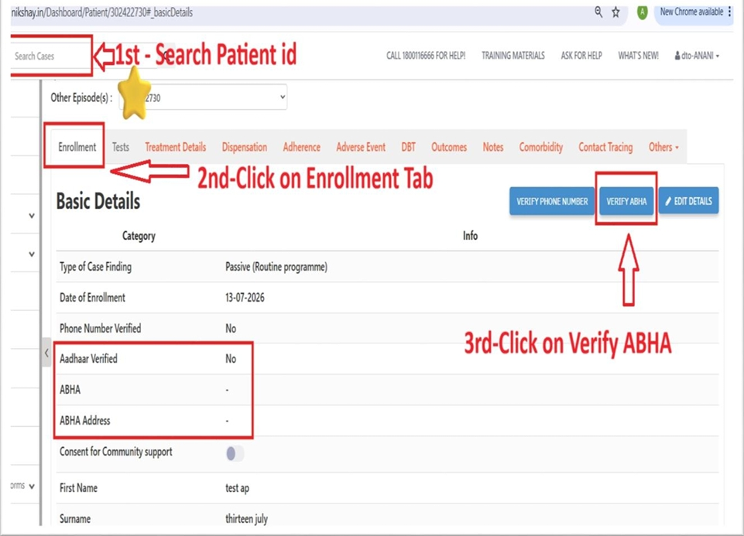
Step 1- Search Patient ID
Step 2- Search Go to Enrollment Tab
Step 3- Click On Verify ABHA

Slide 16
  Click “Continue”
  Select “Biometric Auth”
  Accept acknowledgment checkbox
  Click “Proceed”
  Enter mobile number
  Click “Submit”
  Fingerprint Authentication
Authentication Process

Slide 17
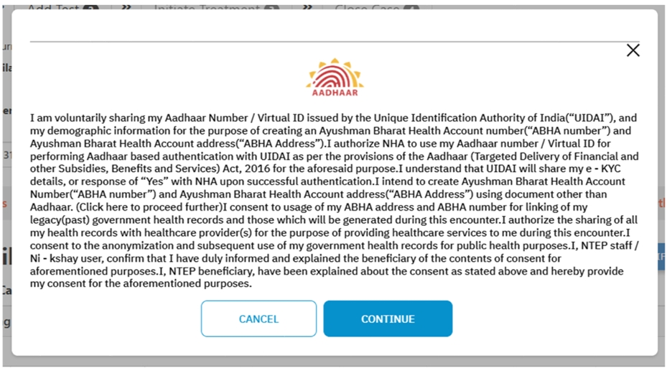
Step – 4 Click on Continue

Slide 18
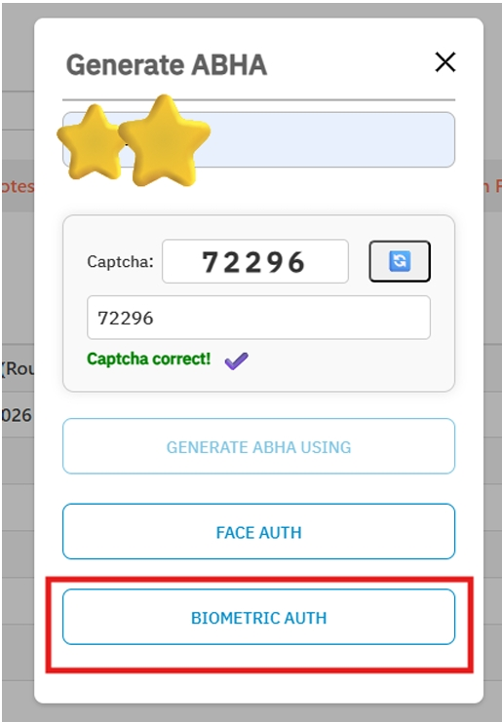
Step – 5 Click on Biometric Auth

Slide 19
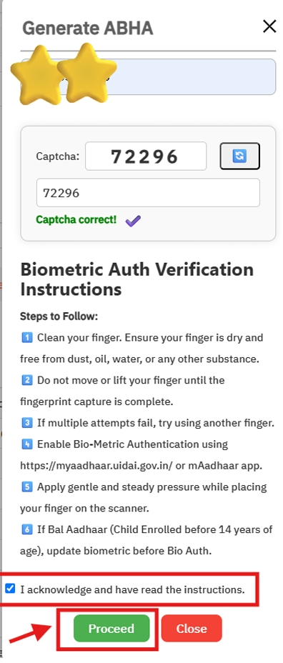
Step –6 Click on Checkbox-I acknowledge
Step –7 Click on Proceed
Step –8 Enter Mobile Number

Slide 20
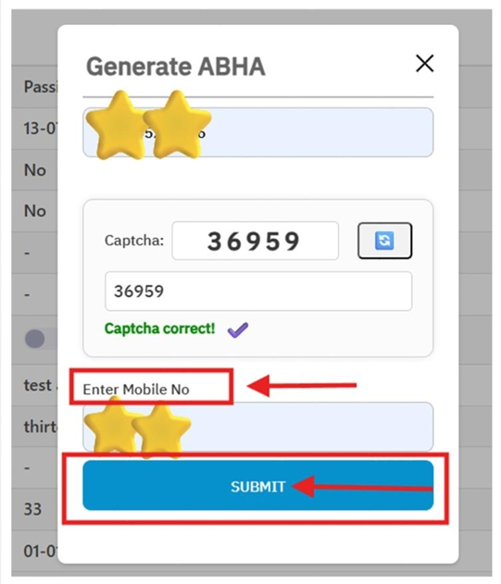
Step – 9 Click on Submit

Slide 21
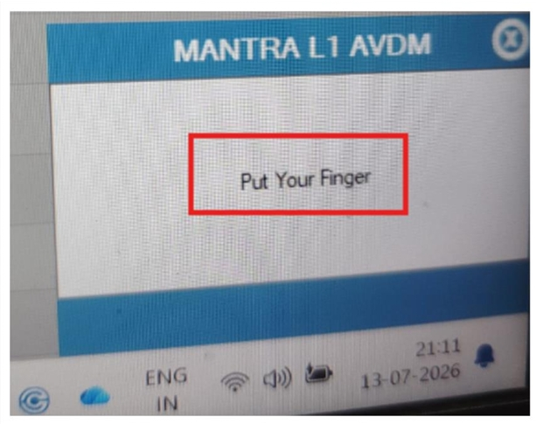
Step – 10 We get this 3rd pop up on screen –Put Your Finger

Slide 22
  Pop-up asks to place finger
  Red light blinks
  Place finger on device
  After Captured Success, Loading starts
  We get ABHA Number
  After successfully done. Please check status on Enrollment Tab
Fingerprint Authentication

Slide 23
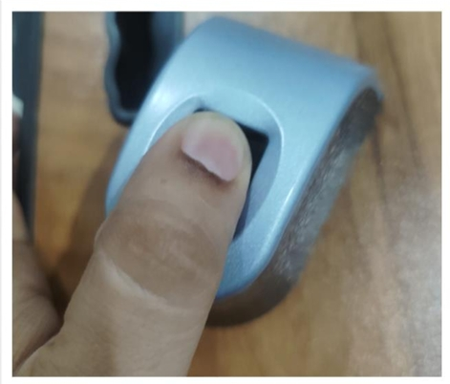
Step 11- When red light blinks > Keep your finger on machine

Slide 24
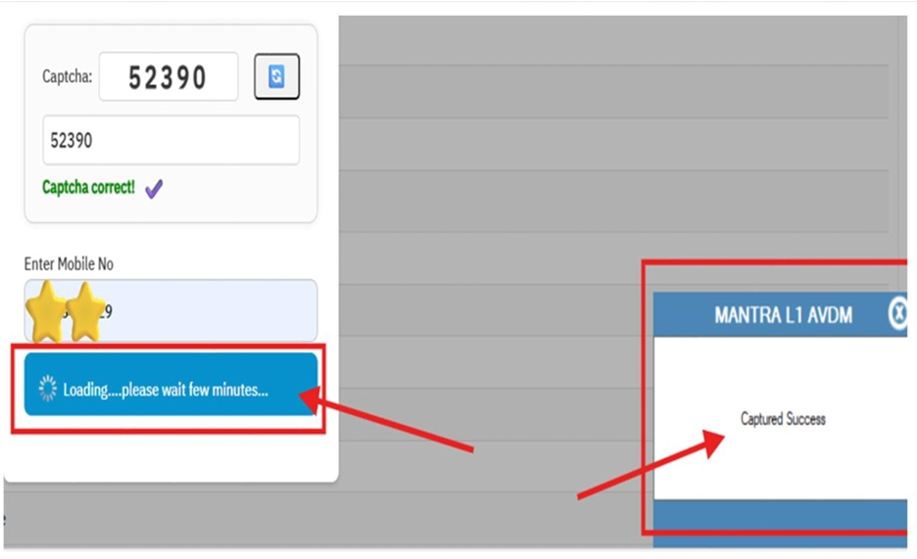
Step 12- After Captured Success, Loading starts

Slide 25
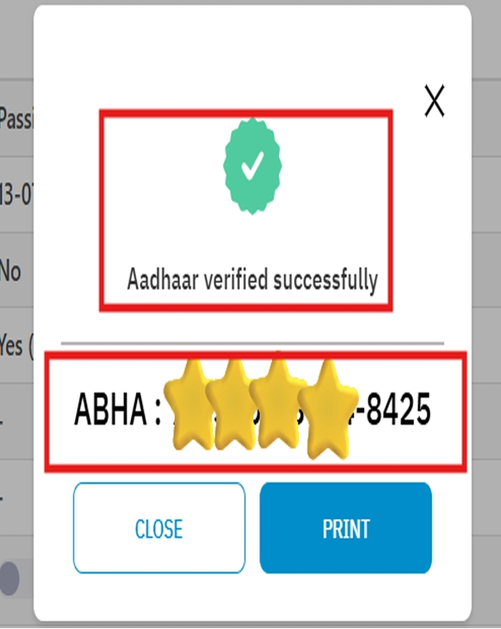
Step 13- We get ABHA Number

Slide 26
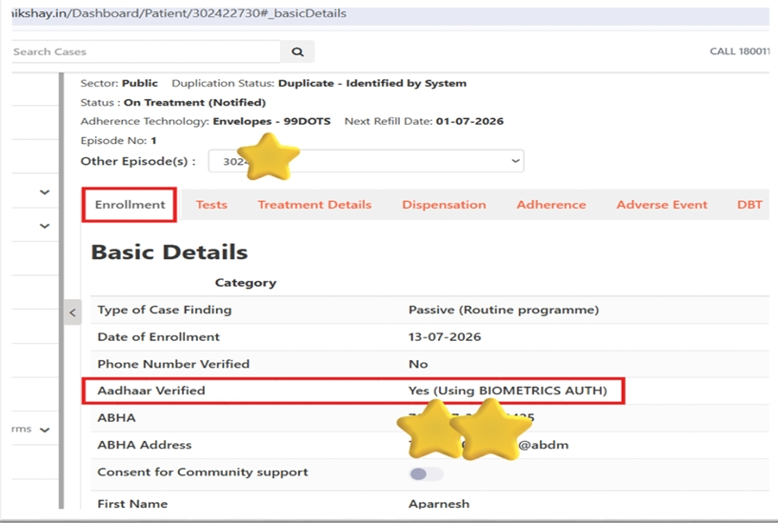
After successfully done. Please check status on Enrollment Tab Number

Slide 27
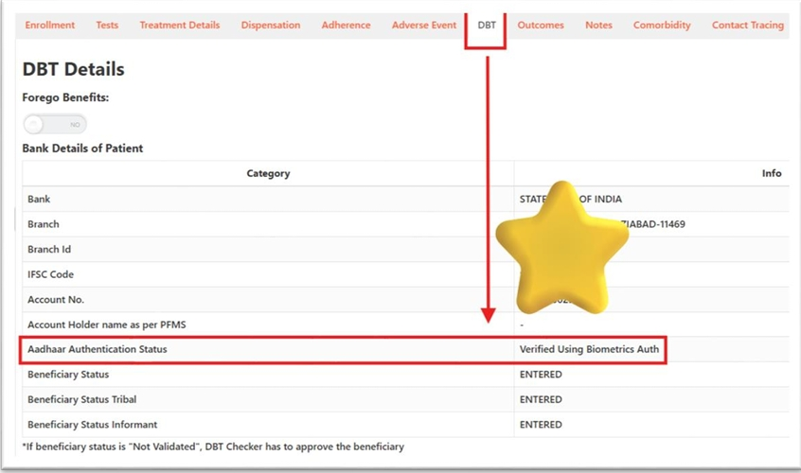
Please check status on DBT Tab

Slide 28
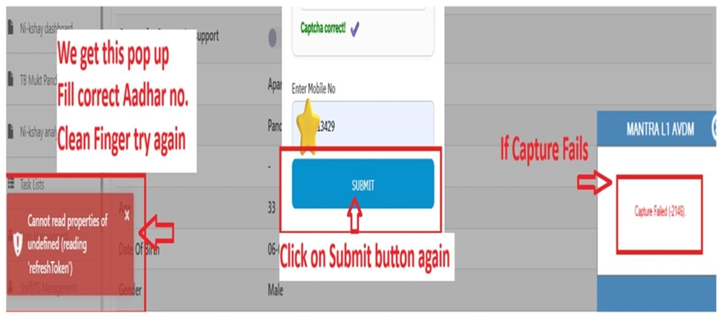
If Authentication Fails​

Slide 29
Click Submit again
Repeat Step 10 to Step 13 again
Put Your Finger
When red light blinks
Keep your finger on machine
After Captured Success, Loading starts
We get ABHA Number
Verify final status

Slide 30
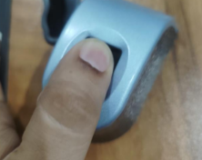
Step – 10 We get this 3rd pop up on screen –Put Your Finger

Slide 31
Step 12- After Captured Success, Loading starts

Slide 32
Step 13- We get ABHA Number

Slide 33
THANK YOU

