Slide 1

ABHA FACE AUTH FOR MOBILE APP

Slide 2
Pre-Installed Applications
Precautions Before Starting
Step 1 – Uninstall Existing Nikshay App
Step 2 – Install New APK
Step 3 - Login & Patient Search
Step 4 - Face Authentication
Authentication Successful Pop-up with ABHA-ID on Mobile Screen UI
Contents

Slide 3
ABHA App
Aadhaar Face RD App
These applications must be installed before starting the process.
Specific driver needs to be installed for biometric device.
Pre-Installed Applications

Slide 4
Ensure good network/Wi-Fi
Maintain proper lighting
Use Aadhaar-registered mobile number
These conditions are necessary for smooth face authentication.
Precautions Before Starting

Slide 5
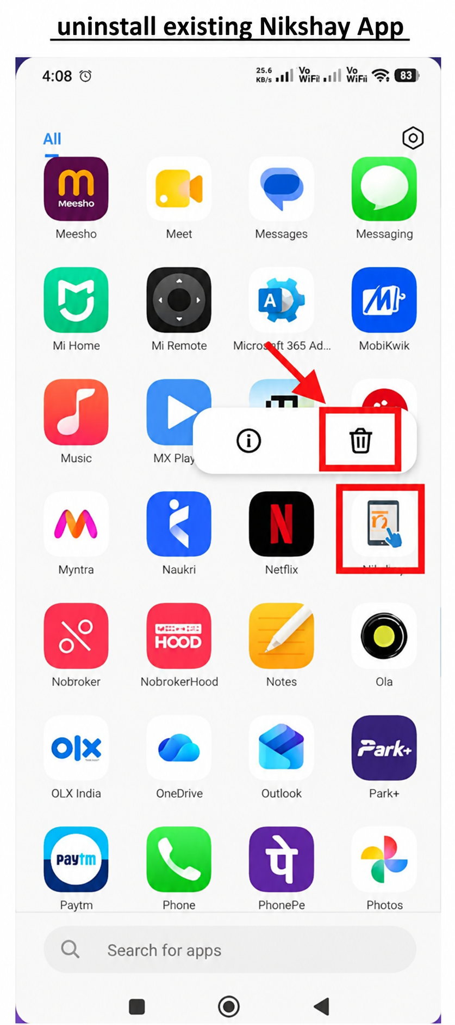
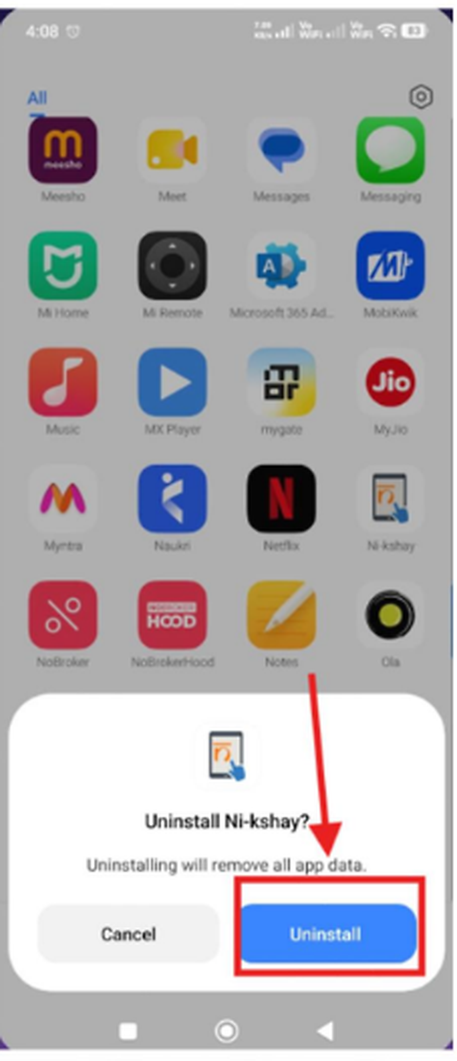
Step 1 – Uninstall Existing Nikshay App

Slide 6
  Install the updated Nikshay app from the provided APK.
  Download APK file
  Install the application
  Click “Continue with Installation”
Step 2 – Install New APK

Slide 7
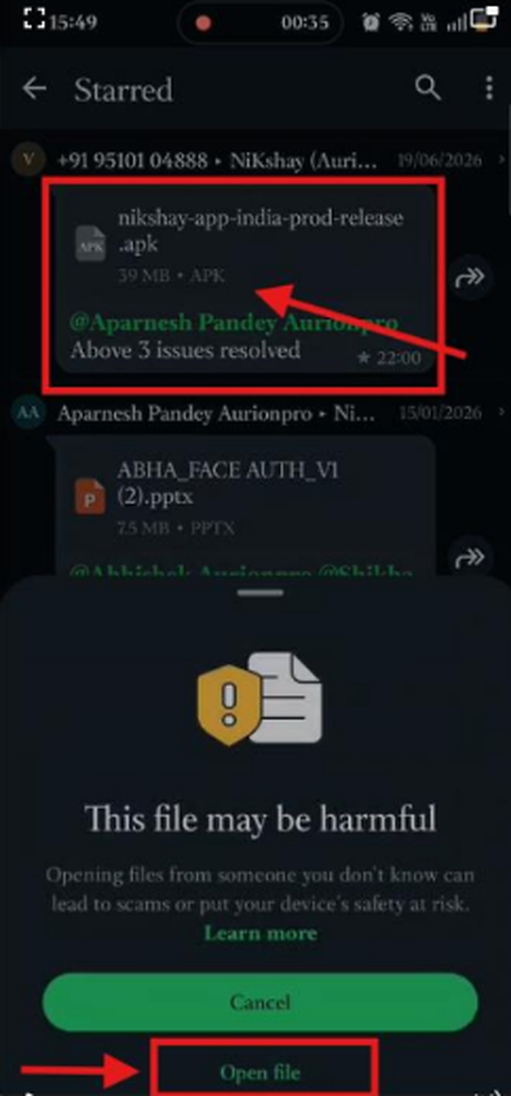

Slide 8
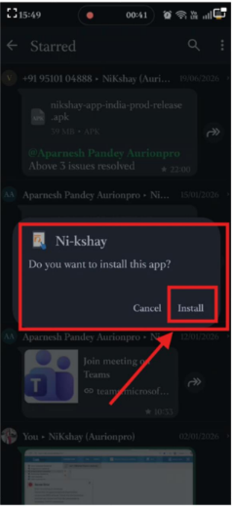

Slide 9
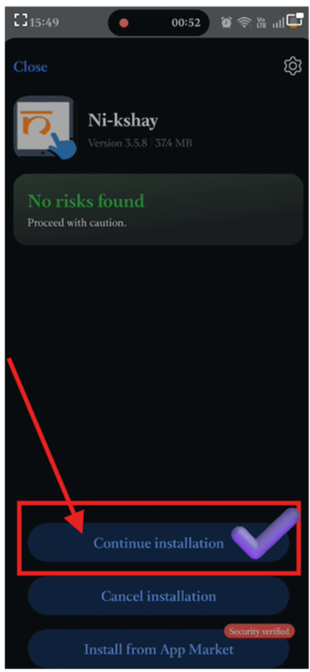

Slide 10
  Open Nikshay App
  Login
  Search patient
  Click “Generate ABHA App”
Step 3-
Login & Patient Search

Slide 11
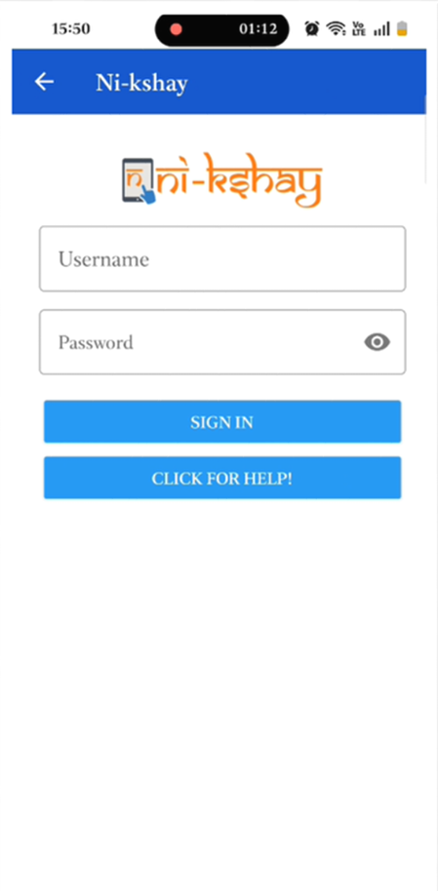

Slide 12
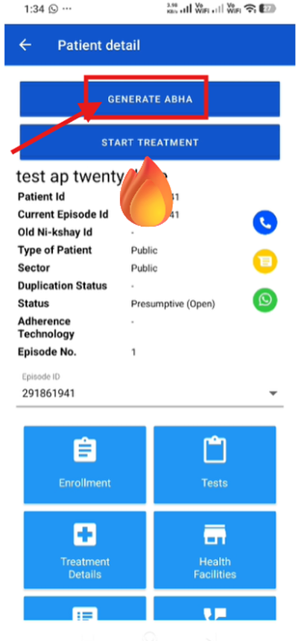

Slide 13
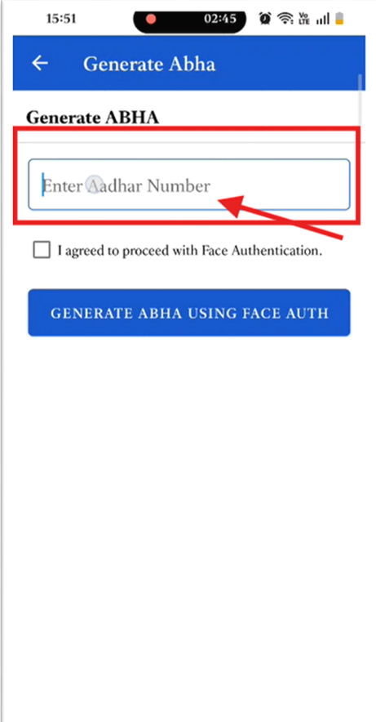

Slide 14
  Click “Continue”
  Enter Aadhaar-registered mobile number
  Click “Proceed”
  ABHA App opens automatically
  Scan face
  Wait for 10–12 seconds
  Close success pop-up
  Authentication success message appears
  ABHA ID displayed
Step 4 -
Face Authentication

Slide 15
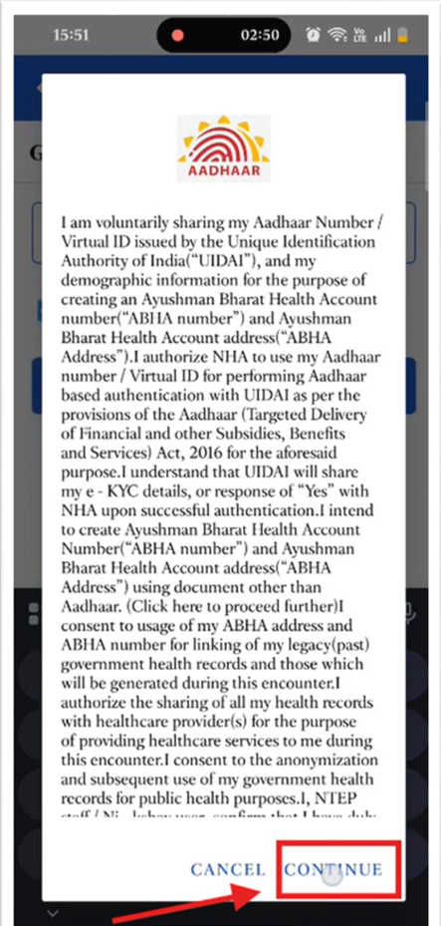
Please click on Continue>>
**Enter Aadhaar Registered Mobile Number

Slide 16
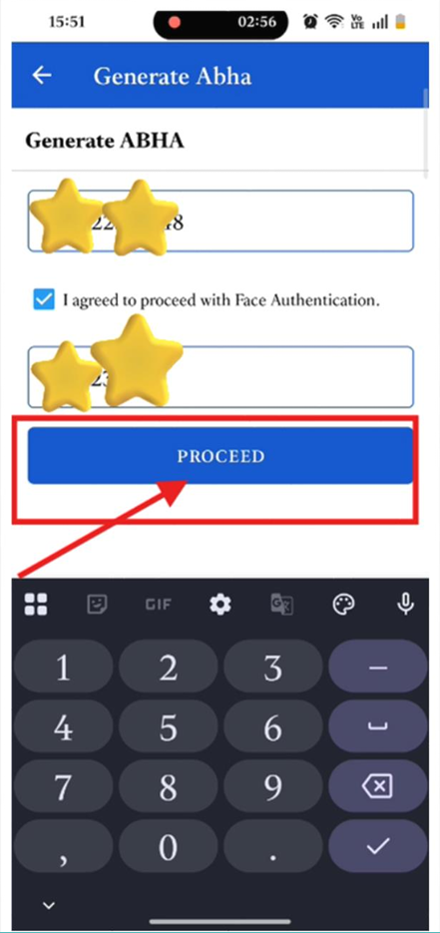
Click on Proceed

Slide 17
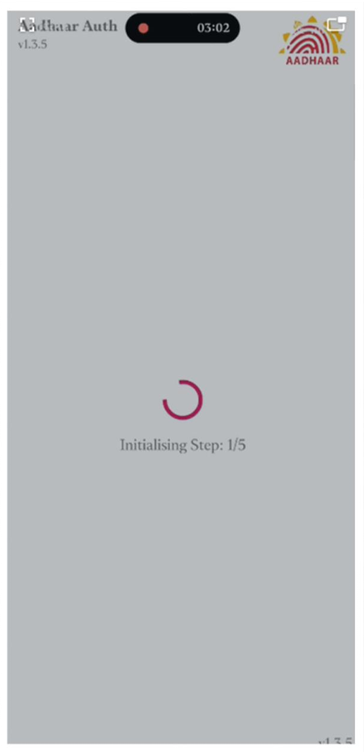
Abha App automatically opens, Please scan Face

Slide 18
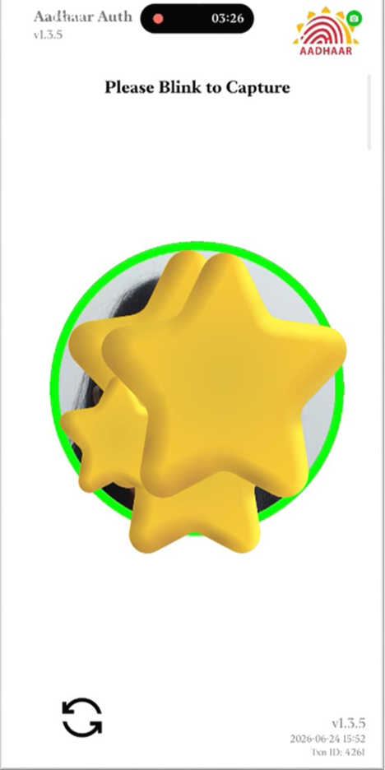
Abha App automatically opens, Please scan Face

Slide 19
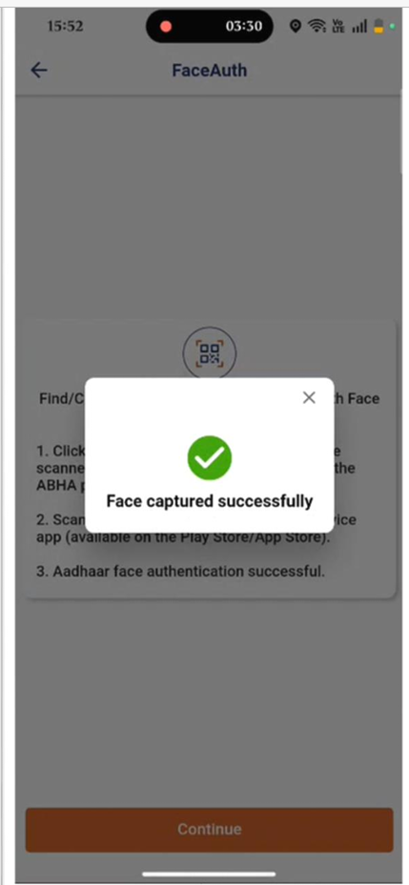
After successful Face
auth wait for 10-12 seconds then close success pop up

Slide 20
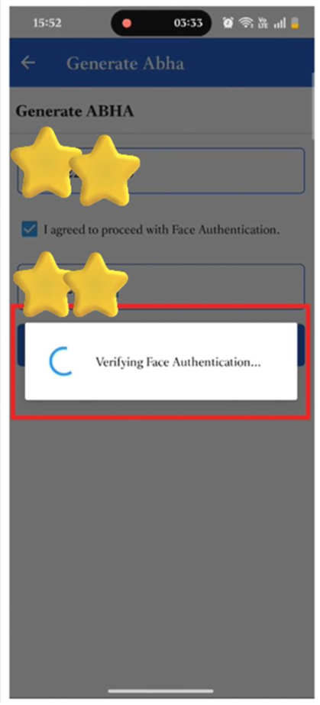
Wait while it is processing

Slide 21
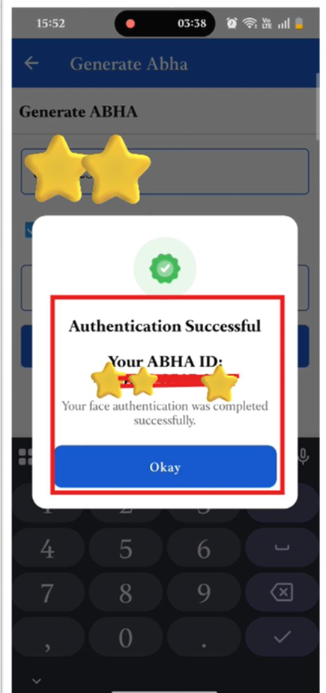
Authentication
Successful Pop-up with ABHA-ID on
Mobile Screen UI

Slide 22
THANK YOU

