Slide 1

SOP- Face Authentication for
Patients

Slide 2
Face Authentication for Patients in Nikshay refers to a digital identity verification feature used to confirm that the actual registered TB patient is receiving services or benefits. It uses facial recognition technology to verify a patient’s identity through a camera-enabled android mobile device.
Overview

Slide 3
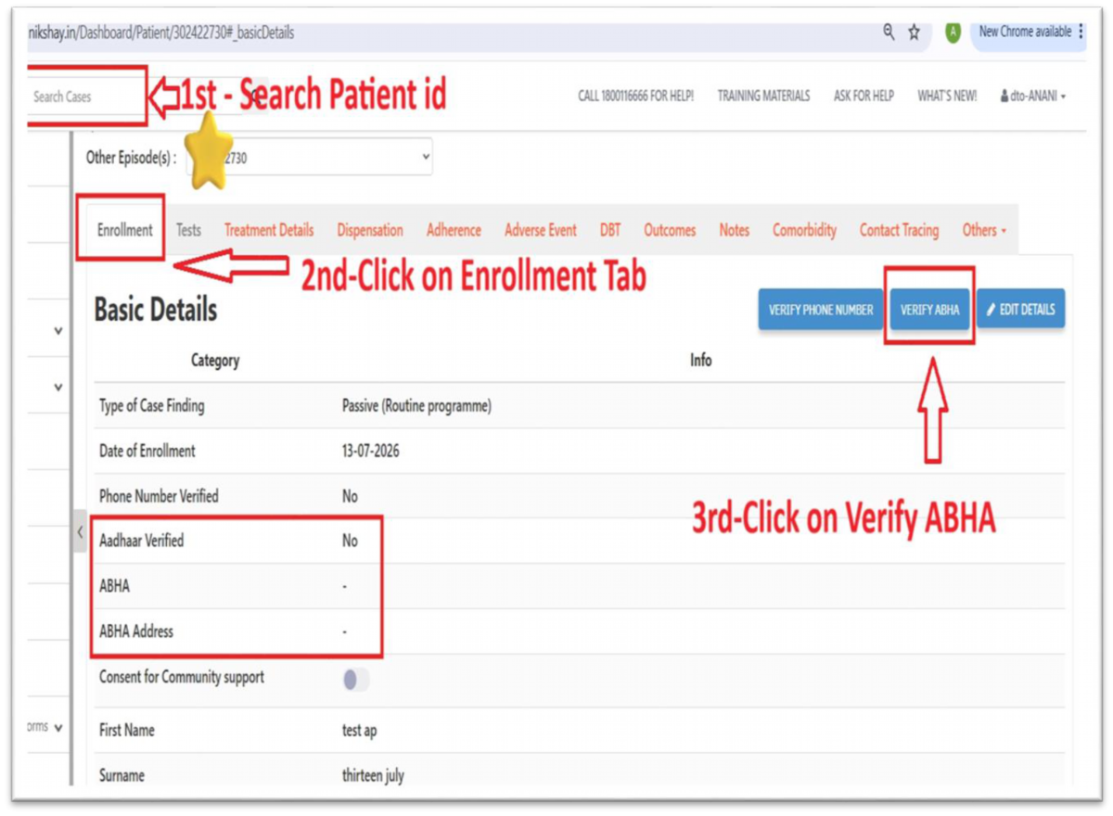
Steps:
Login with credentials
example: DTO/TU/PHI
1.Go to Search Patient Id
2.Click on Enrollment Tab
3. Verify on ABHA

Slide 4
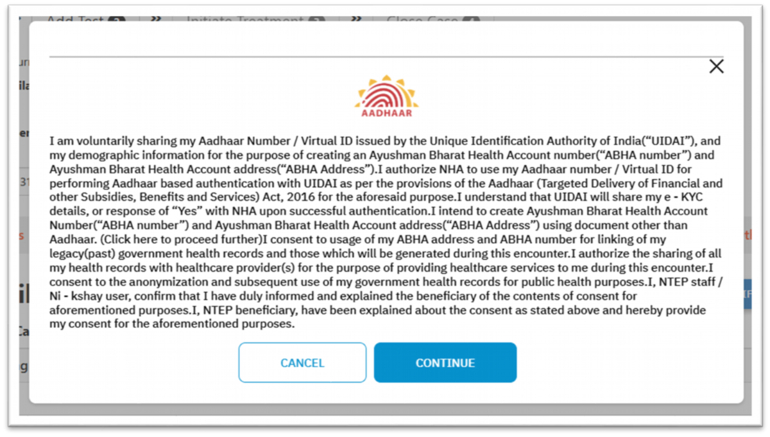
3. Click on Generate ABHA
Step 4: Click on Continue
3. Click on Generate ABHA
3. Click on Generate ABHA
3. Click on Generate ABHA
3. Click on Generate ABHA
3. Click on Generate ABHA

Slide 5
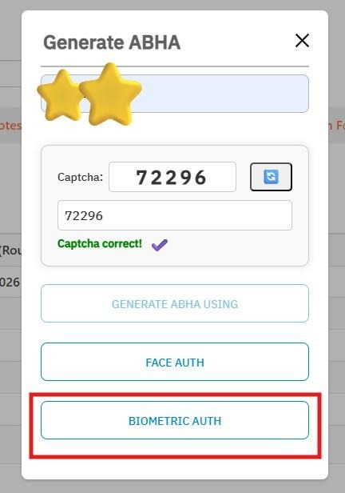
Step 5: Click on Face Auth

Slide 6
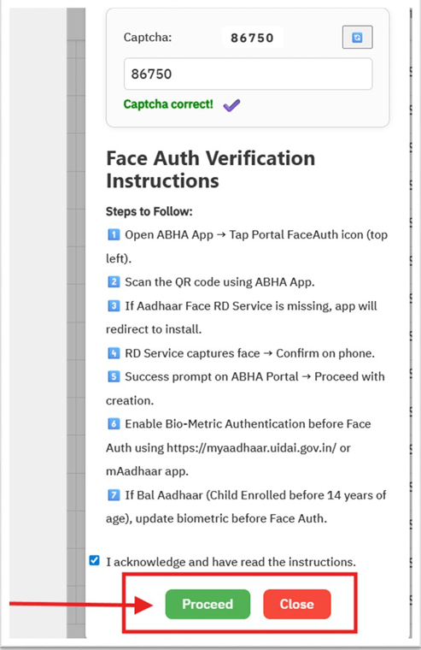
Step 6: Click on Proceed

Slide 7
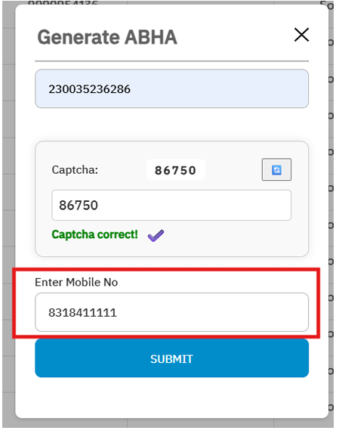
Step 7: Enter Mobile Number

Slide 8
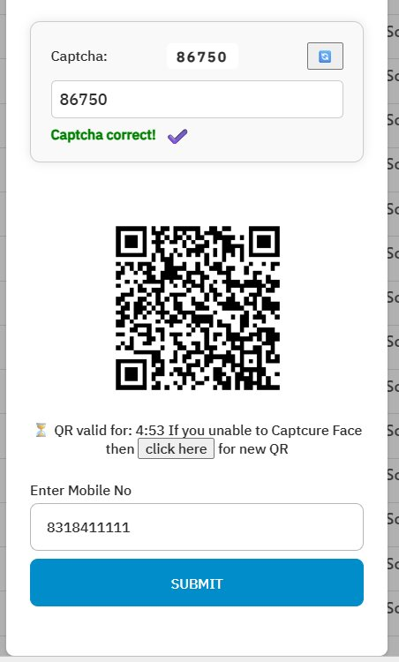
Scan this QR code with pre installed ABHA App and Face RD

Slide 9
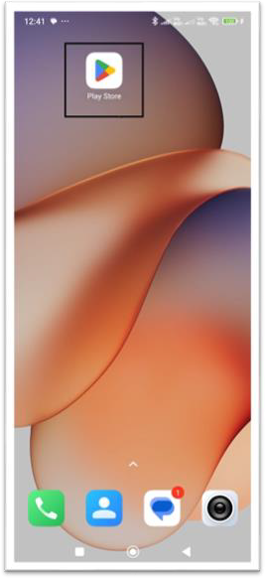
Step 1-
Go to play Store In
Mobile Phone

Slide 10
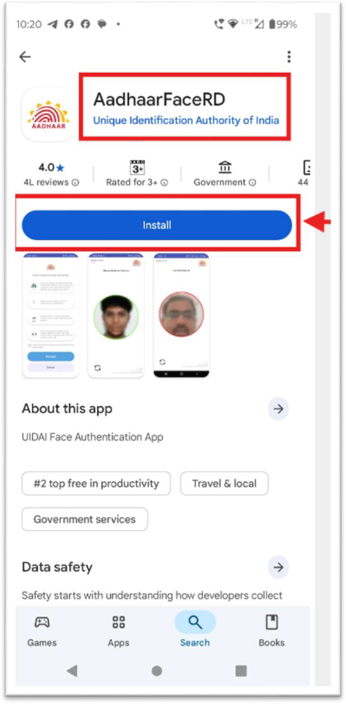
Step 2 -Type and search ABHA Face RD App & ABHA App in
Search box

Slide 11
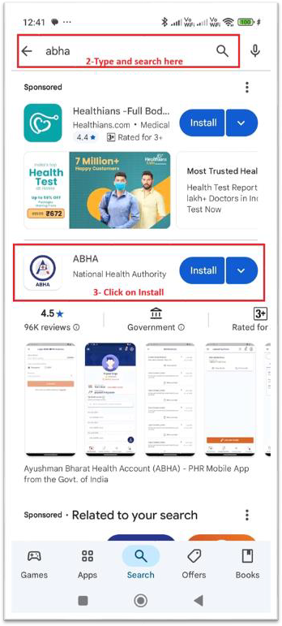
STEP-3
Click on Install
Step 3 – Click on Install

Slide 12
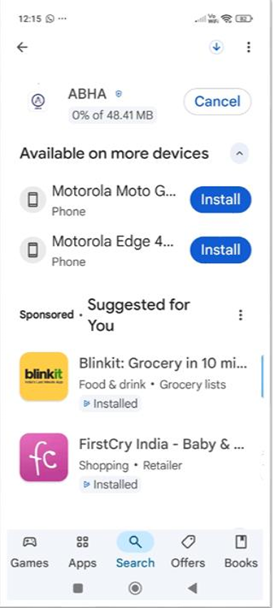
Installation in Progress

Slide 13
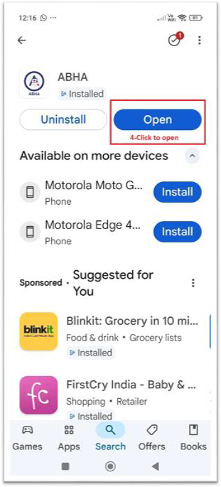
Step 4- Click On Open

Slide 14
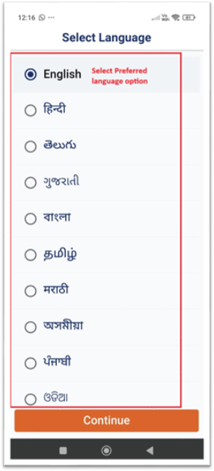
Step 5-
Click to select
Preferred Language

Slide 15
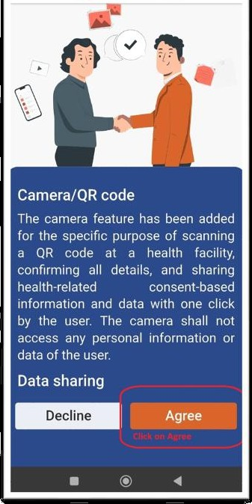
Step 6-
Click to Agree

Slide 16
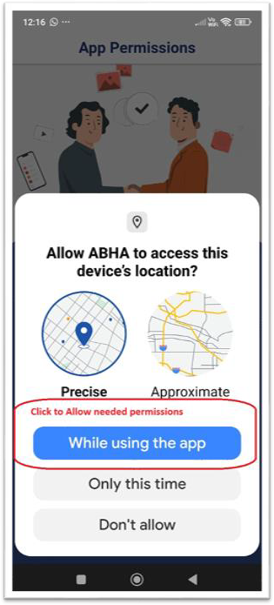
Step 7-
Click to Allow
Necessary permission

Slide 17
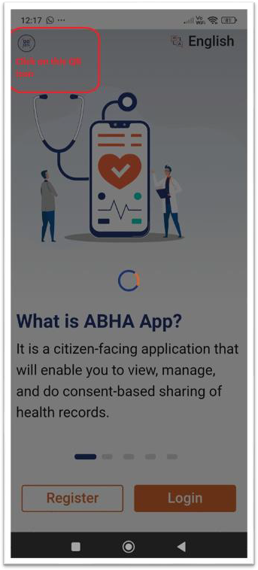
Step 8-
Click to QR code Icon
on Top left corner

Slide 18
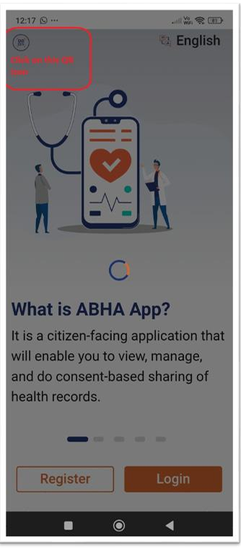
Step 9-
Click to Continue

Slide 19
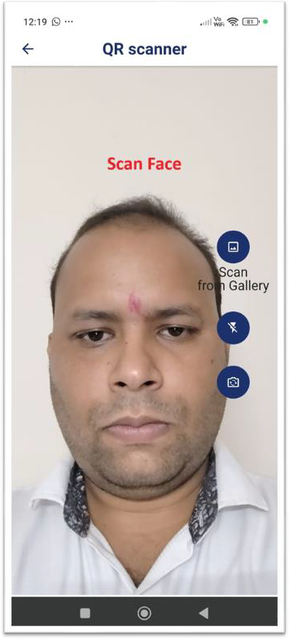
Step 10-
Scan Face

Slide 20
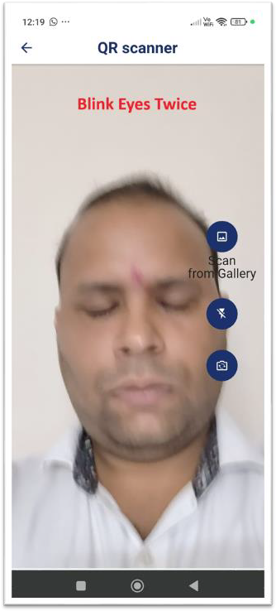
Step 11-
Blink Eyes Twice

Slide 21
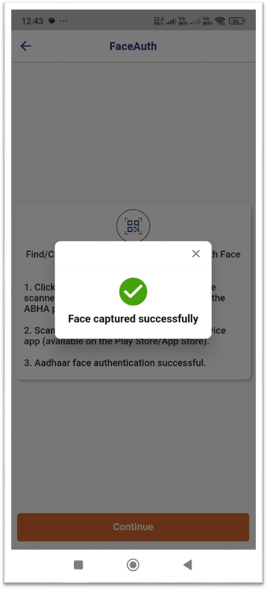
After Successful
authentication we
will get this
message

Slide 22
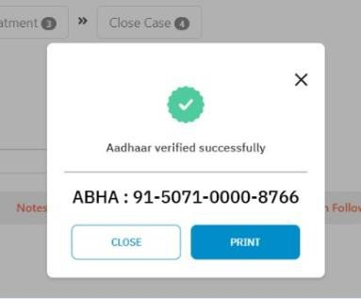
Nikshay gives this message on device

Slide 23
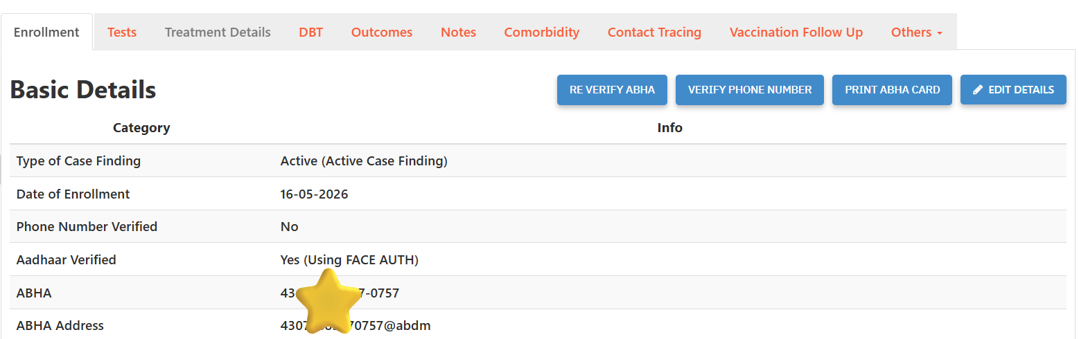
Aadhar Verified Type updated successfully on Enrollment Tab

Slide 24
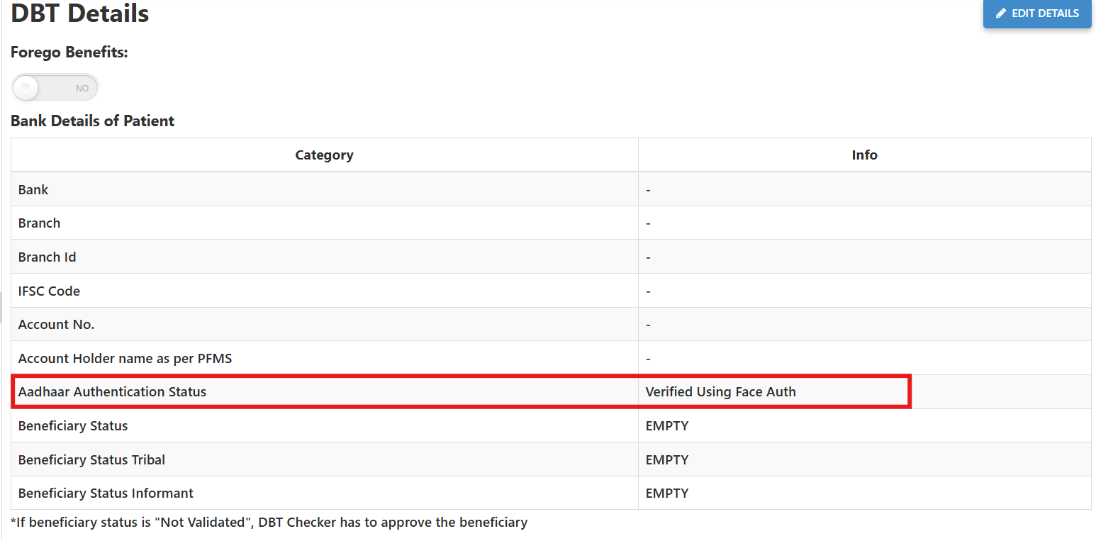
Aadhar Authentication Status successfully updated on DBT Tab

Slide 25
THANK YOU

