Slide 1
Contact tracing changes – Nikshay Web + App
Training Material
V 1.1 - 29.04.2021

Slide 2
Introduction and Context
In the latest release we have brought about changes in the functionality of the Contact Tracing module
These changes are applicable to both web and app products and will take effect immediately
The aim of this material is to document all the changes that have been made in the contact tracing module and also help in understanding the usage of the new Contact Tracing module

Slide 3
What has changed in the new version?
We have removed the 2 sections present in the contact tracing module before: “Under 6 years” and “Above 6 years” and replaced it with a single section for all age groups
The fields have been kept same as before with the only change being replacing “No.” with “Number”
Provided an option to add and enroll contacts as Beneficiaries (Presumptive TB/TPT beneficiaries) in Nikshay
Removed the option to add chemoprophylaxis. For information of TB Preventive therapy beneficiaries (erstwhile chemoprophylaxis), user would have to enter the enrollment details
The following 2 fields have also been added to capture the contacts on TPT:
Number Eligible for TPT
Number Provided TPT

Slide 4
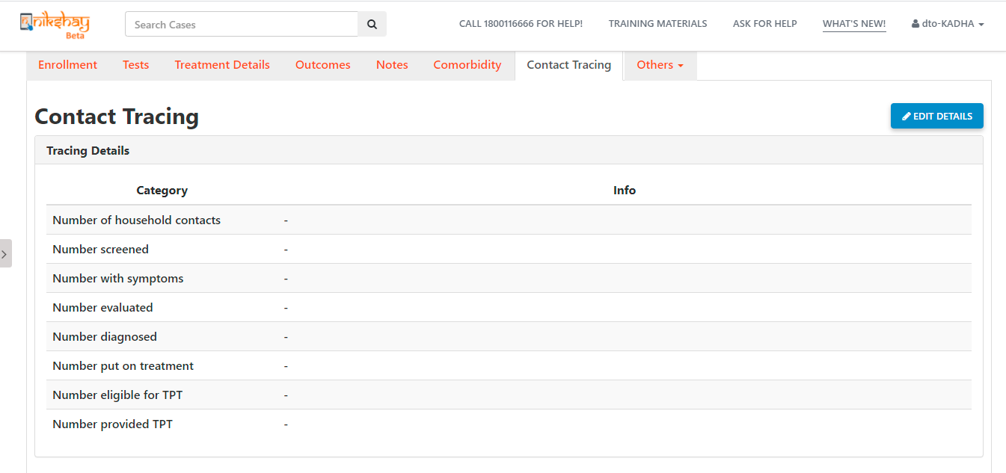
Current flow of the Contact tracing module
At the moment the contact tracing tab for any TPT Beneficiary looks like below:

Slide 5
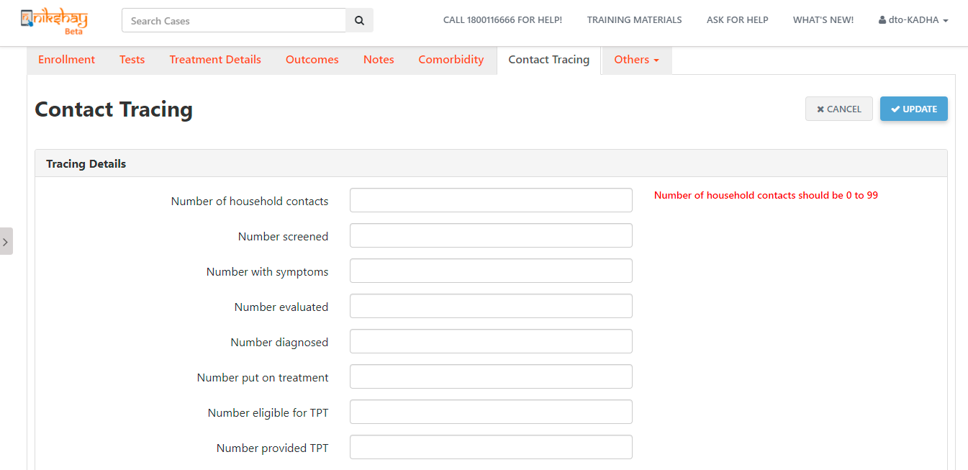
Current flow of the Contact tracing module
In order to add details of the contacts, the users will click on the “Edit Details” button present and will land on a form as shown below:

Slide 6
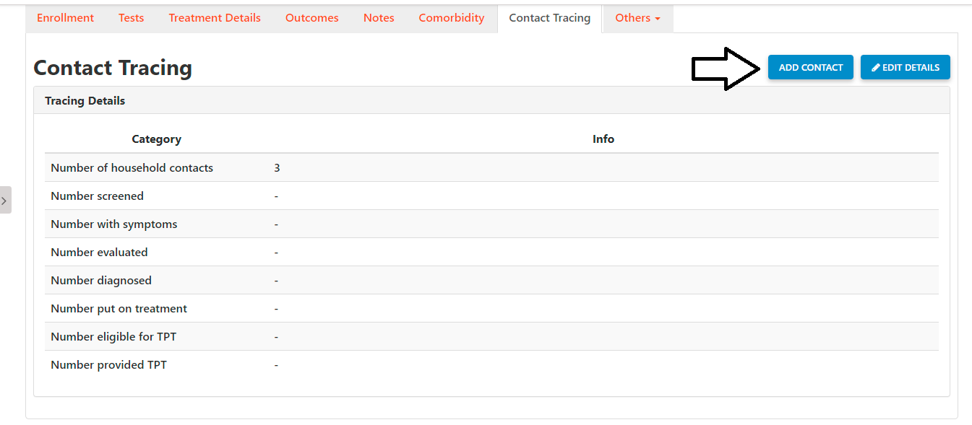
Current flow of the Contact tracing module
Once the user enters the different fields and saves the information he lands on the screen as shown below.
If the number of household contacts is at least 1, then a button appears at the top of the contact tracing tab “Add Contact”, which can be used to add contacts as Beneficiaries (Presumptive TB/TPT beneficiaries) in the Nikshay system

Slide 7
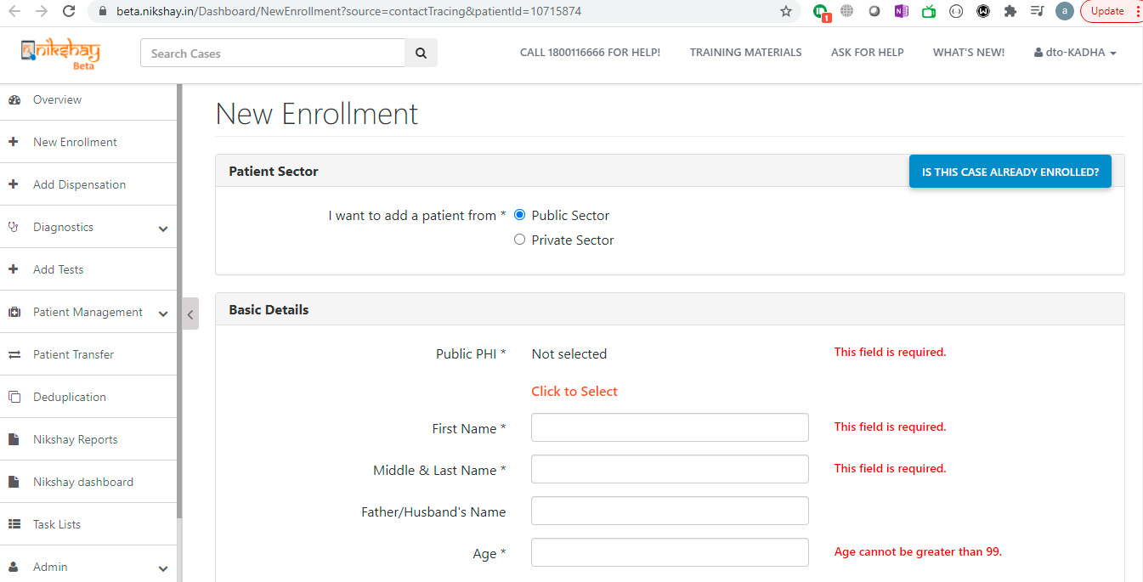
Current flow of the Contact tracing module
Once the button “Add Contact” is clicked the user is taken to the enrolment form as shown below:

Slide 8
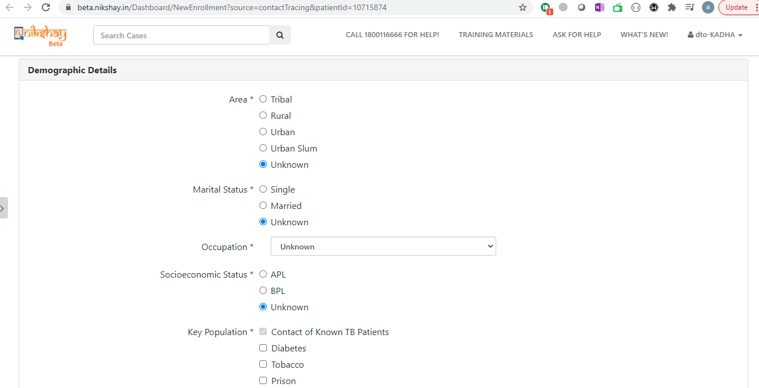
Current flow of the Contact tracing module
This flow is similar to adding a New presumptive TB case in Nikshay except that the option of “Contact of Known TB Patient” is automatically selected for the field “Key Population”
Apart from this additional options such as “Patient on immunosuppressants”, “Silicosis”, “Anti-TNF treatment”, “Dialysis”, “Transplantation” have also been added as part of the “Key Population” field. Multiple key population can be selected for a patient

Slide 9
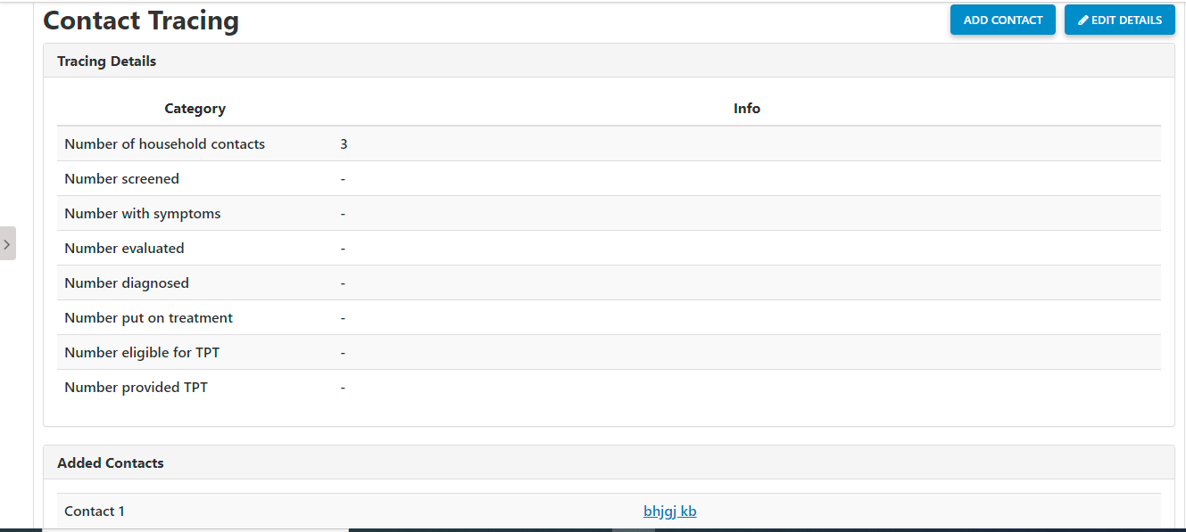
Current flow of the Contact tracing module
Once the Contact is added as a beneficiary (Presumptive TB / TPT beneficiary) in the system, the contact details can be seen in the contact tracing tab as shown below:

Slide 10
Migrations
All the Existing records will be migrated and shown in the new contact tracing module
Since there were 2 sections before and just a single section now, post migration the figures will represent the sum of the figures present for both sections
For example if before the contact tracing tab had 4 household contacts under 6 and 4 household contacts over 6 then after migration the contact tracing tab for patient will show the consolidated figure of 8 household contacts
TB treatment information for all age groups would be available in contact tracing module, while for information of TPT Beneficiary, user would have to enter the enrollment and diagnostic details

