Slide 1
MODULE 7: PRIVATE PROVIDER (HF) INCENTIVES SCHEME

Slide 2
About the Scheme
Incentives of Rs. 500 for Notification and Outcome Declaration will be provided to Private Provider (HF)
Presently, Nikshay enables users to pay only the ‘Private Health Facilities’ for Notification of TB patients and also for referring cases (informing) to Public Sector laboratories for diagnosis.
The ability to pay other informants for referral for diagnosis and to TB patients for self-notification will be added subsequently within the same scheme. For the time being these need to be paid manually by PFMS.
Staff and Treatment Supporters

Slide 3
DBT processing via Nikshay
Following are the 6 steps to be followed for processing payments in Nikshay under this scheme.
1
Registration of Private Provider
2
Update Bank details of Private Provider
(Once per Private provider)
3
Approval of Bank Details by DBT Checker
4
Auto generation of benefits by Nikshay
5
Approval of Benefit by DBT Maker
(Once per benefit)
6
Approval of Benefit by DBT Checker
As this benefits are accepted in PFMS, they have to be approved in PFMS via DA Login

Slide 4
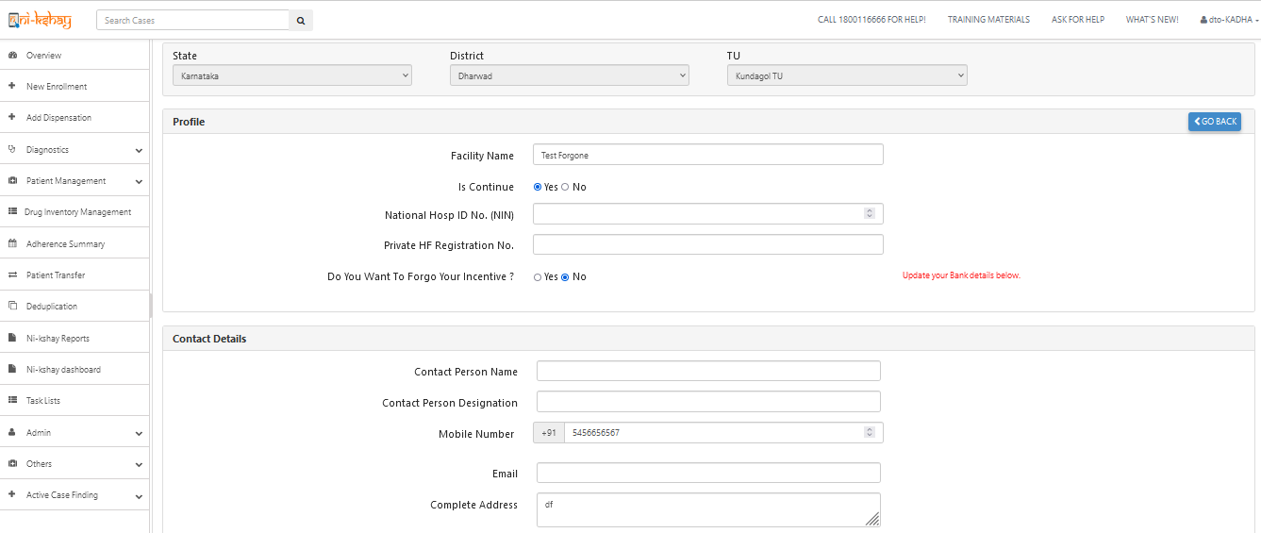
Step 1: Registration of Private Provider (HF) in Nikshay
Private Provider (HF) can be registered by a DTO or TU Login or by a Open form available in Nikshay Home Page and Default value for forgone as “NO”
If Provider is active, select ‘Yes’
Default value is selected “NO” & enter Bank details
Mobile No. must be unique

Slide 5
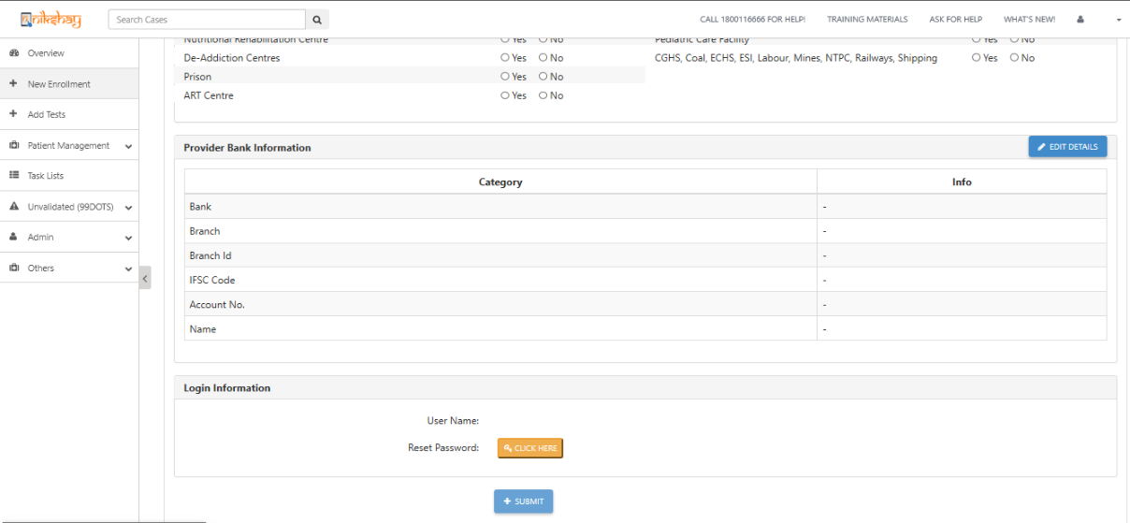
Step 2: Update Bank details of Private Provider (HF)
Enter Bank details

Slide 6
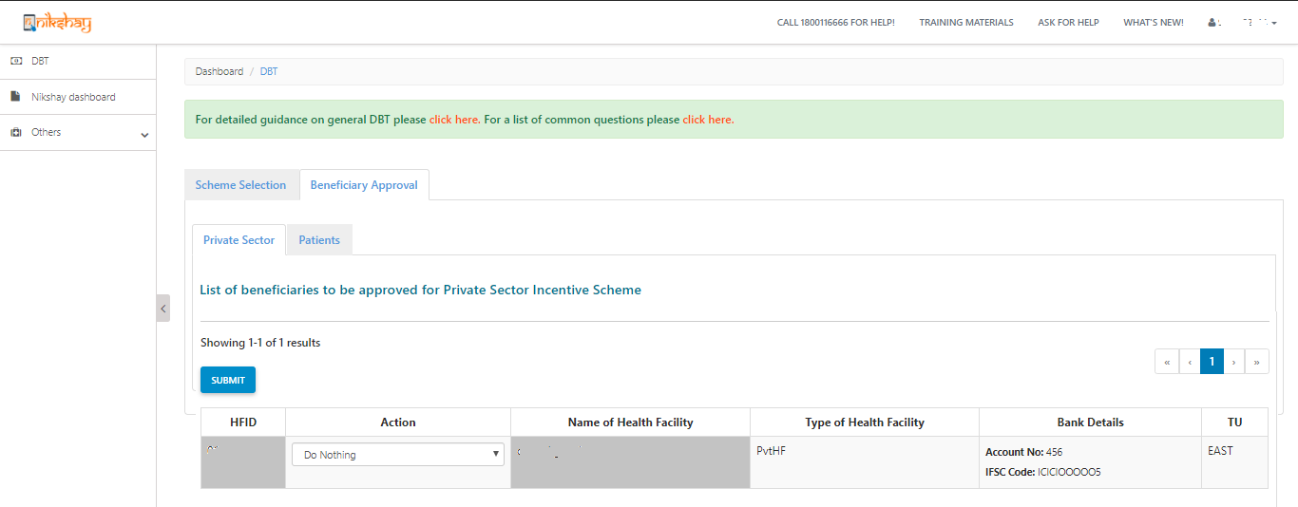
Step 3: Approve Bank Details from DBT Checker Login
As the Bank details of a Private Health Facility are entered, it is sent to DBT Checker for Approval. Such records are seen in “Beneficiary Approval” 🡪 “Private Sector” page.
If any Private Health Facility’s Bank details are pending approval with DBT Checker, its Beneficiary Status will be “Not Validated”

Slide 7
Step 4: Auto generation of benefits by Nikshay
Pre-requisites for Benefit generation under the scheme
The Private Health Facility should be in Active Status i.e.. “is Continue” should be selected as “Yes”
For the Private Health Facility “Do you want to forego incentive” should be selected as “No”
The Bank Account details of the Private Health Facility should be approved by DBT Checker and its Status should be “Validated”
Nikshay will generate Benefits only for episodes notified after “30th July 2019”. For all prior notifications, benefits may be paid directly through PFMS
Benefit will only be generated if the notified episode is “System identified Unique” or “Unique marked by users”.
Benefit will NOT be generated if episodes are marked as “System identified – Duplicates” and pending approval by user or “User marked - Duplicates”.

Slide 8
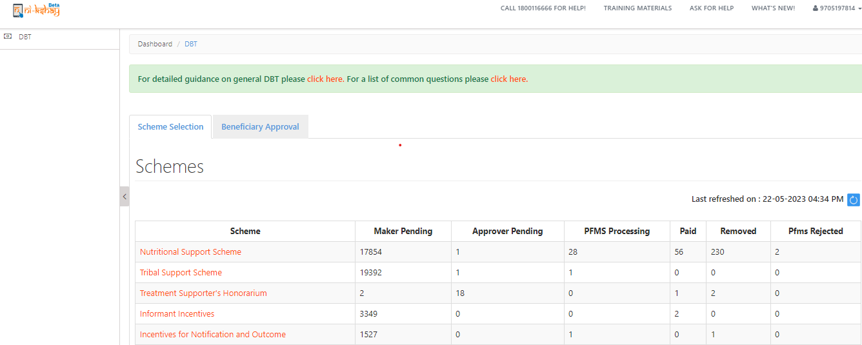
Step 4: Auto generation of benefit via Nikshay
Benefits generated under the scheme will be visible to DBT Maker in the “Pending” tab of the scheme

Slide 9
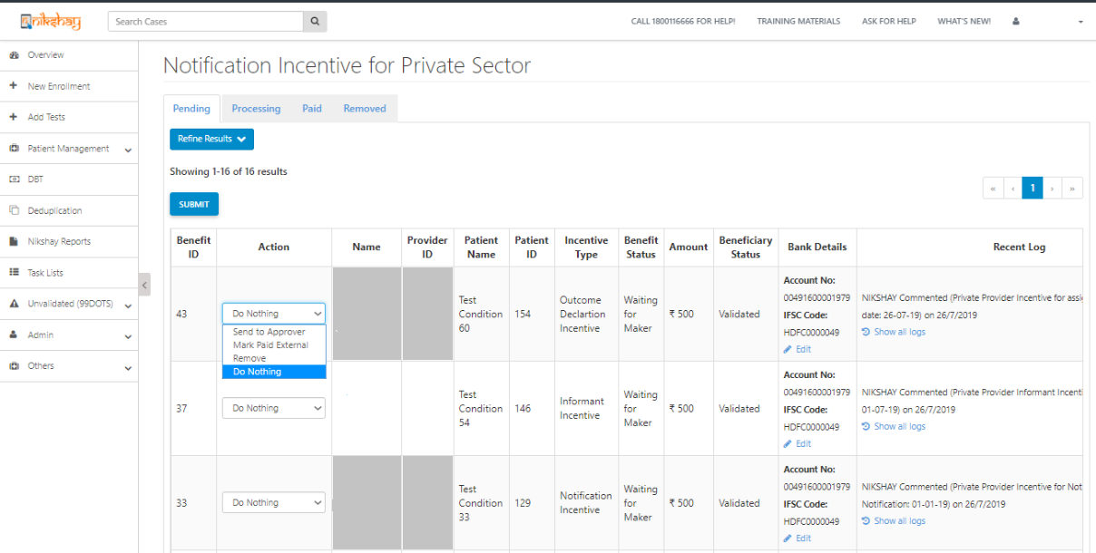
Step 5: Approval by DBT Maker

Slide 10
Step 6: Approval by DBT Checker

Slide 11
Scenarios where notification incentive would be applicable
AddedBy | HierarchyMapping_Enrollment | HierarchyMapping_Diagnosed | Eligible Beneficiary | Incentive Type
HUB | HUB | PVTLAB | HUB | NOTIFICATION
PHI | PHI | PVTLAB | PVTLAB | NOTIFICATION
PVTCHEM | PVTCHEM | PVTLAB | PVTCHEM | NOTIFICATION
PVTLAB | PVTLAB | PVTLAB | Enrollment PVTLAB | NOTIFICATION
PVTHUB / State Jeet / District Jeet | HUB | PVTLAB | HUB | NOTIFICATION
TU | PHI | PVTLAB | PVTLAB | NOTIFICATION
TU | HUB | PVTLAB | HUB | NOTIFICATION
DISTRICT | PHI | PVTLAB | PVTLAB | NOTIFICATION
DISTRICT | HUB | PVTLAB | HUB | NOTIFICATION
INFORMANT | PHI | PVTLAB | PVTLAB | NOTIFICATION
SYMPTOM CHECKER - SELF | PHI | PVTLAB | PVTLAB | NOTIFICATION
SYMPTOM CHECKER - OTHERS | PHI | PVTLAB | PVTLAB | NOTIFICATION
PVTCHEM | PVTCHEM | PVTCHEM | PVTCHEM | NOTIFICATION
HUB | HUB | HUB | Enrollment HUB | NOTIFICATION
PVTHUB / State Jeet / District Jeet | HUB | HUB | Enrollment HUB | NOTIFICATION
TU | HUB | HUB | Enrollment HUB | NOTIFICATION
DISTRICT | HUB | HUB | Enrollment HUB | NOTIFICATION
Note: 1. Where there are two HFs involved, Informant (i.e. Enrolling HF facility) gets priority over Diagnostic facility
2. Benefits will be created in districts where private health facility is registered.
3. If a TU and above (Including JEET/ CC) enrolls a case on behalf of private health facility, and then refers a case for diagnosis to a public sector lab, then private health facility is not eligible for “Informant Incentive” i.e. Private Health facility has to login and refer cases for diagnosis to public sector to be eligible for “Informant Incentive”

Slide 12
Outcome Incentives
This incentive will be generated when a patient’s Treatment Outcome is declared
Benefit will be generated only if Outcome is declared from “Private Practitioner/Clinic etc. (Single)” and “Hospital/ Clinic/ Nursing Home etc. (Multi)” irrespective of notification done.

Slide 13
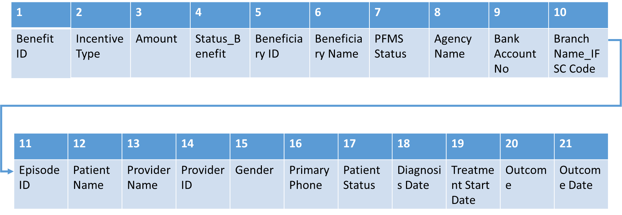
Report available to Private Provider (HF)

